Slide 1
A Tribe Called Programmer
The Software Developer Community and Why You Should Join
Jerry D’Antonio Software Developer
Presented at The University of Akron Senior Seminar, Computer Science Dr. Kathy Liszka
Notes:
## Introduction
*"A community is a social unit of any size that shares common values."* --Wikipedia
* Humans are social...
* Humans are tribal...
* Together we are strong...
* The software developer community offers many exciting opportunities
- Pragmatic: Build a professional network that can help land a better job
- Educational: Improve your skills
- Social: Spend time with like-minded individuals
- Civic: Give back
* Several ways you can participate in the developer community:
- Open source
- Conferences
- Meetup groups
- Hackerspaces
- Hackathons
- Civic hacking

Slide 2
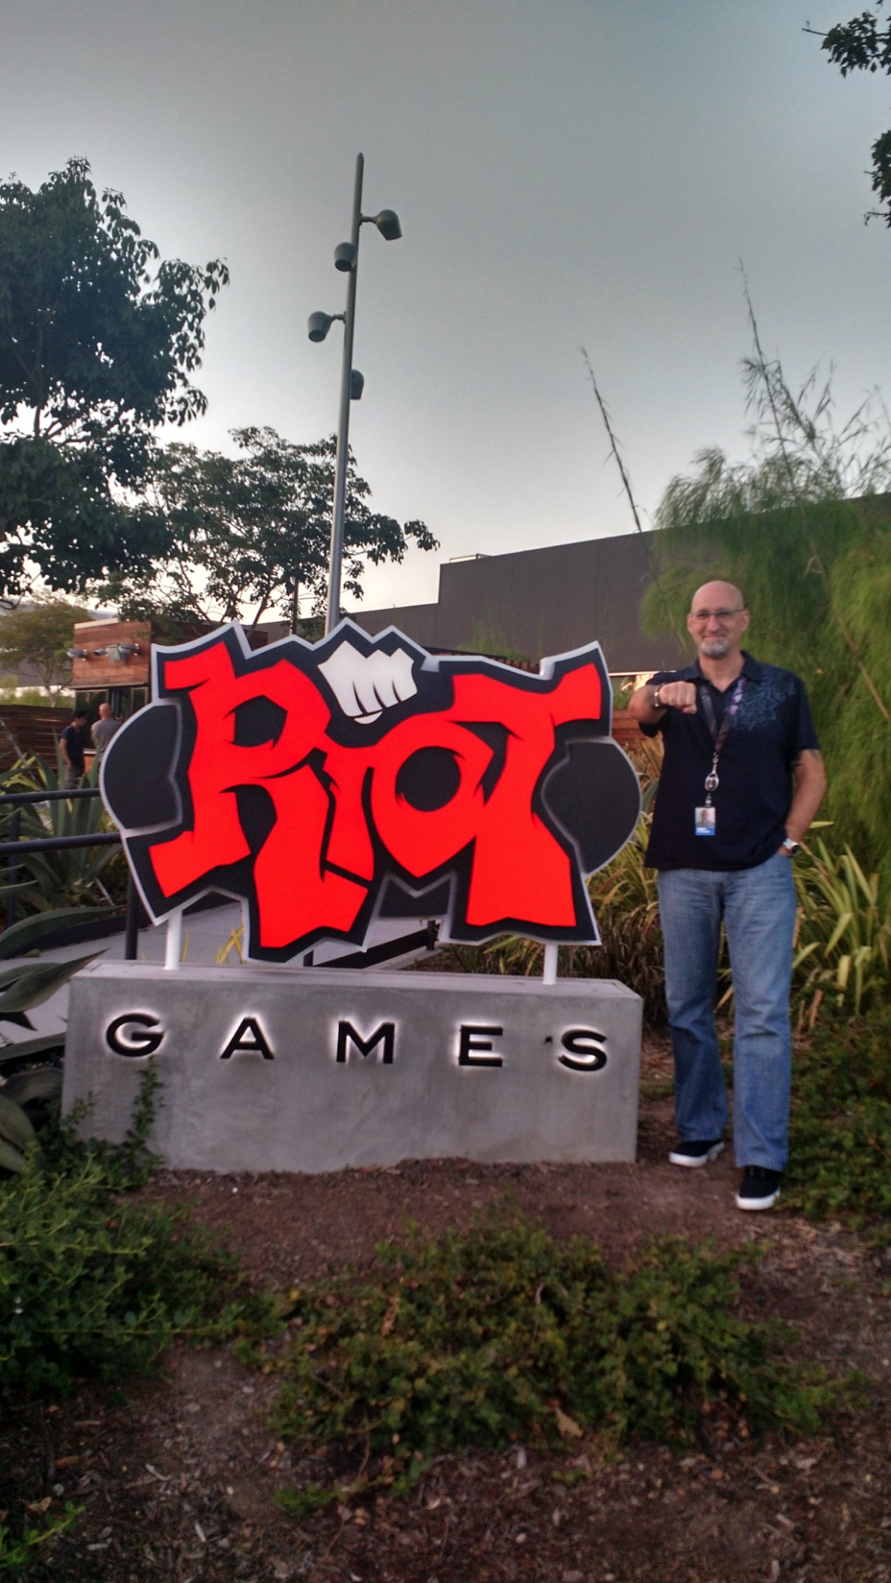
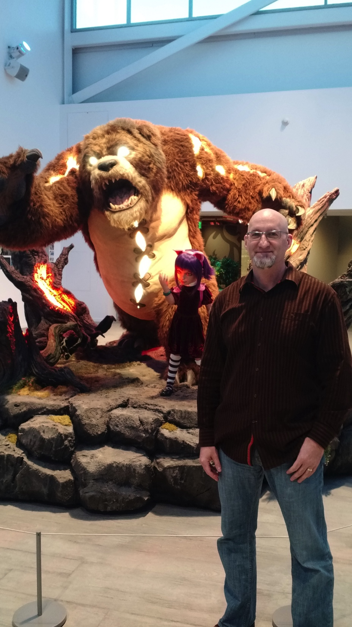
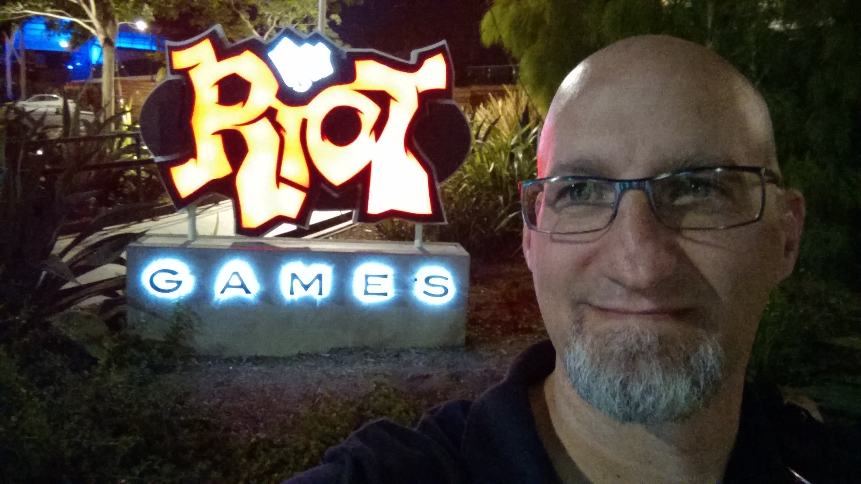

Slide 3
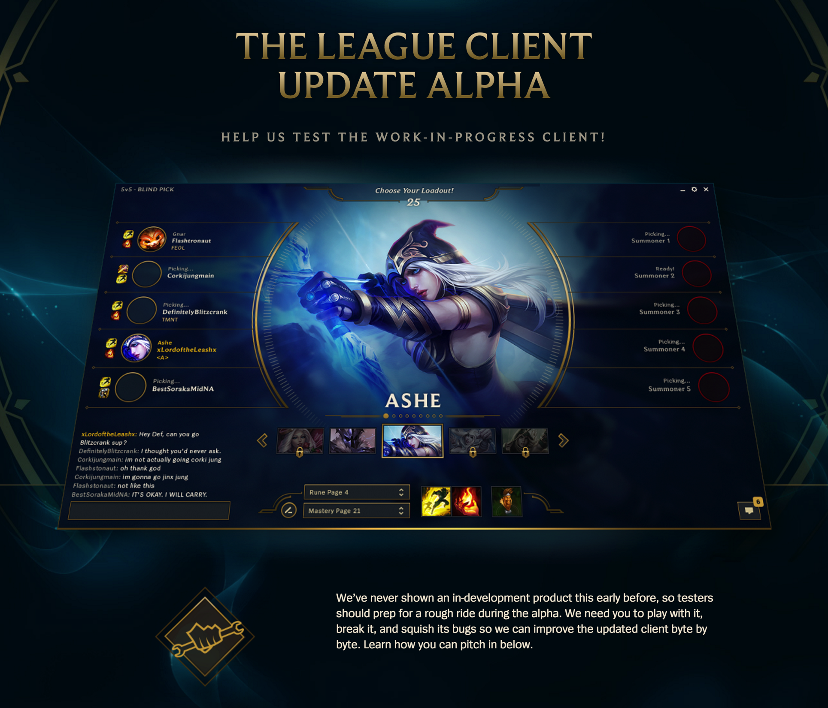

Slide 4
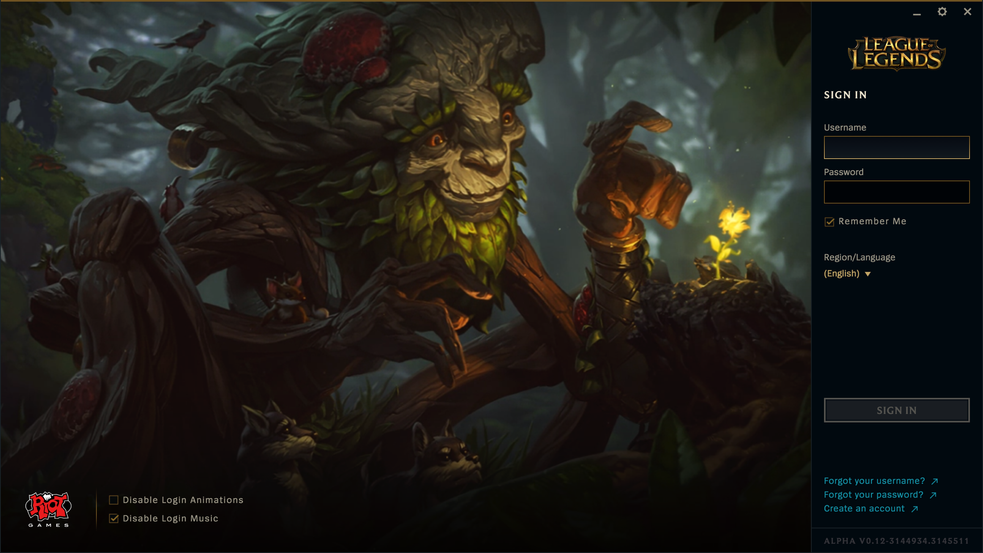
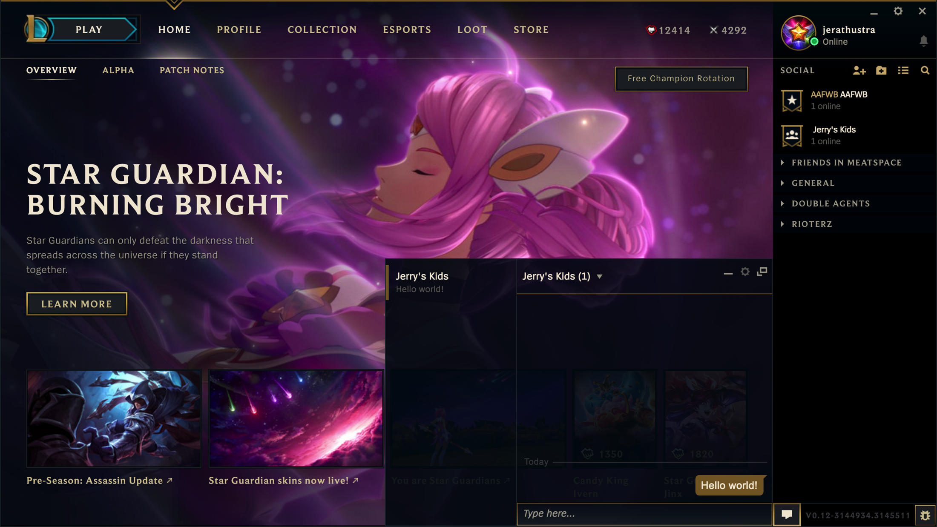

Slide 5
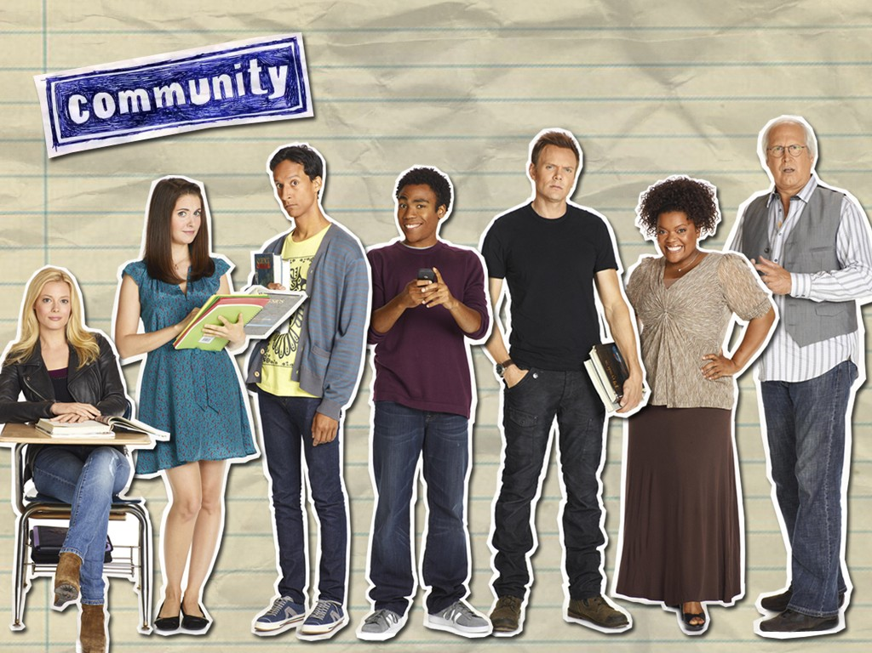

Slide 6
"A community is a social unit of any size that shares common values."
Wikipedia

Slide 7

Humans are social…

Slide 8
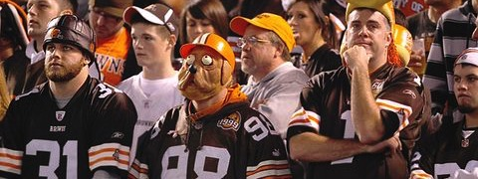
Humans are tribal…

Slide 9
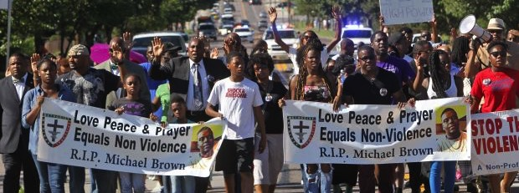
Together we are strong…

Slide 10
A Tribe Called Programmer
The software developer community offers many exciting opportunities:
Pragmatic: Build a professional network that can help land a better job
Educational: Improve your skills
Social: Spend time with like-minded individuals
Civic: Give back

Slide 11
A Tribe Called Programmer
Several ways you can participate:
Open source
Conferences
Meetup groups
Hackerspaces
Hackathons
Civic hacking

Slide 12
Open Source
“free” as in “free speech,” not as in “free beer”
Notes:
## Open Source
*"Open source software is software that can be freely used, changed, and shared (in modified or unmodified form) by anyone."* --Open Source Initiative
*"free" as in "free speech," not as in "free beer"* --GNU Operating System
"The Cathedral and the Bazaar"
Ways to contribute to open source:
* Documentation
* Bug/issue lists
* Test coverage
* Create new projects
* Take over fallow projects
Open source etiquette:
* Follow the published rules
* Adopt their style
* Be polite and respectful
* Be open to feedback and requested changed
* Don't be discouraged if your work isn't accepted

Slide 13
Open Source Software
"Open source software is software that can be freely used, changed, and shared (in modified or unmodified form) by anyone.”
-- Open Source Initiative

Slide 14
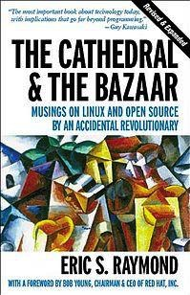
What is Open Source?
Eric S. Raymond’s seminal work “The Cathedral & The Bazaar” was one of the first explorations of this modern phenomenon
Today it is estimated 35.9% of the servers on the public internet run Linux (Wikipedia)
Over 47M downloads of the Rails framework

Slide 15
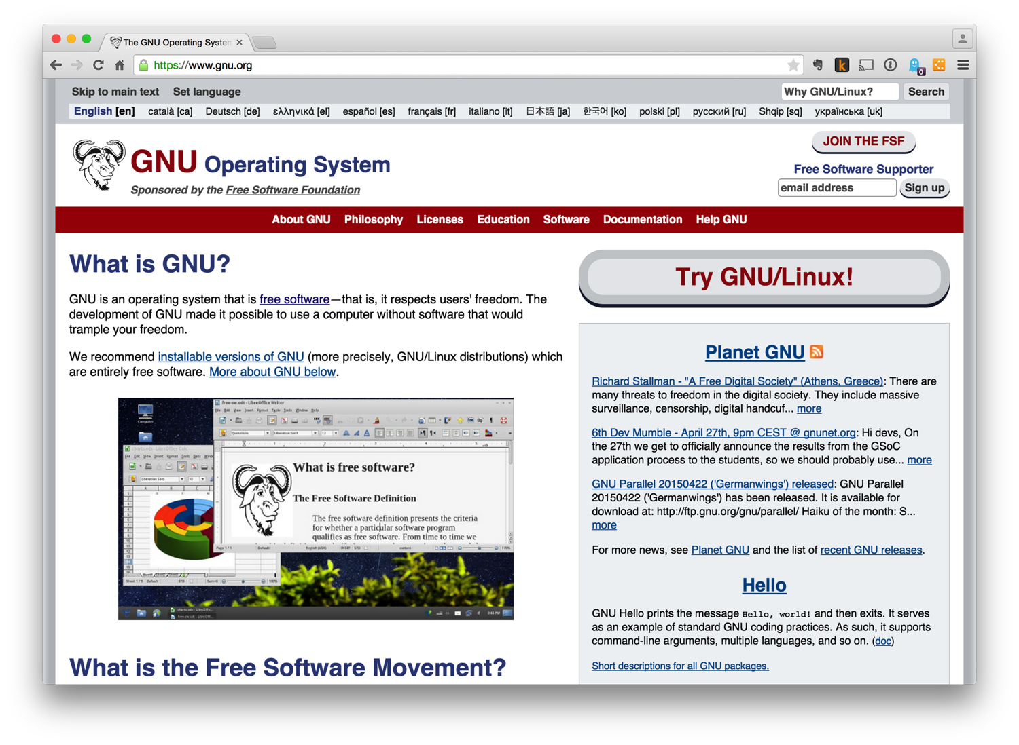

Slide 16
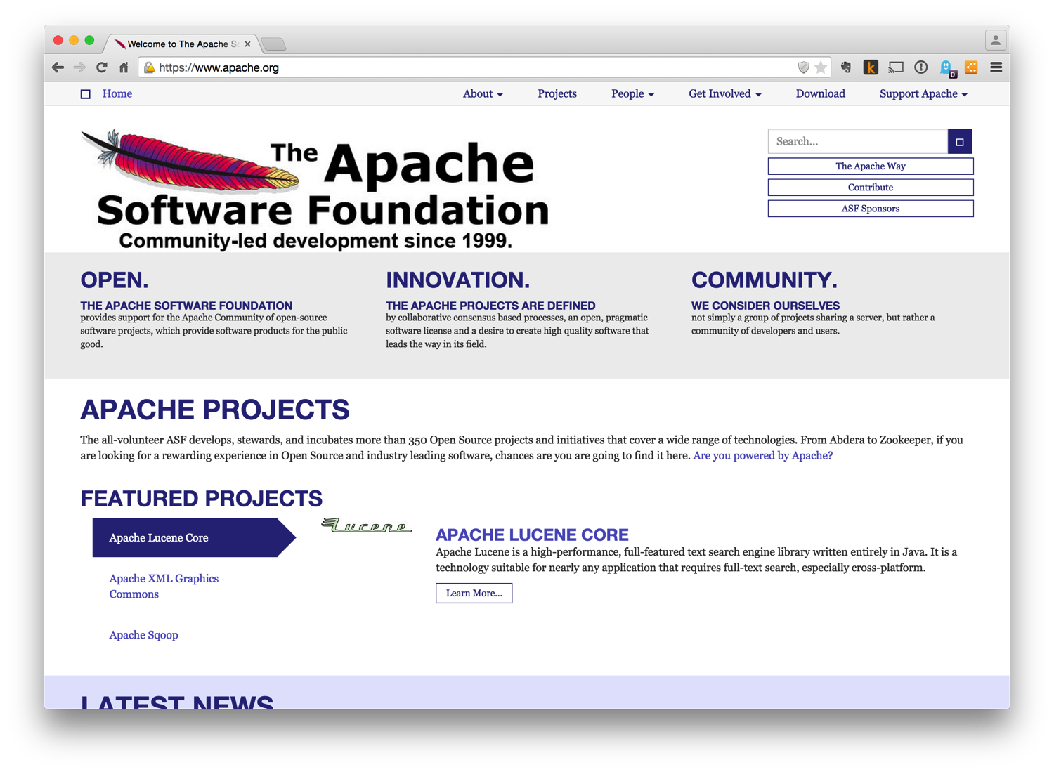

Slide 17
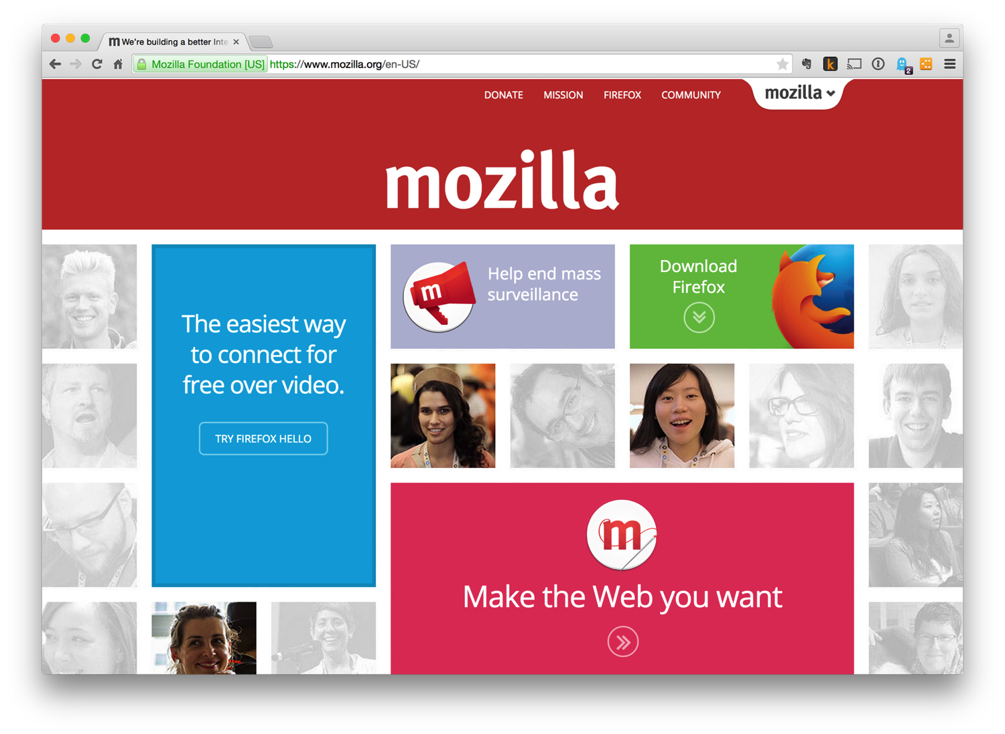

Slide 18
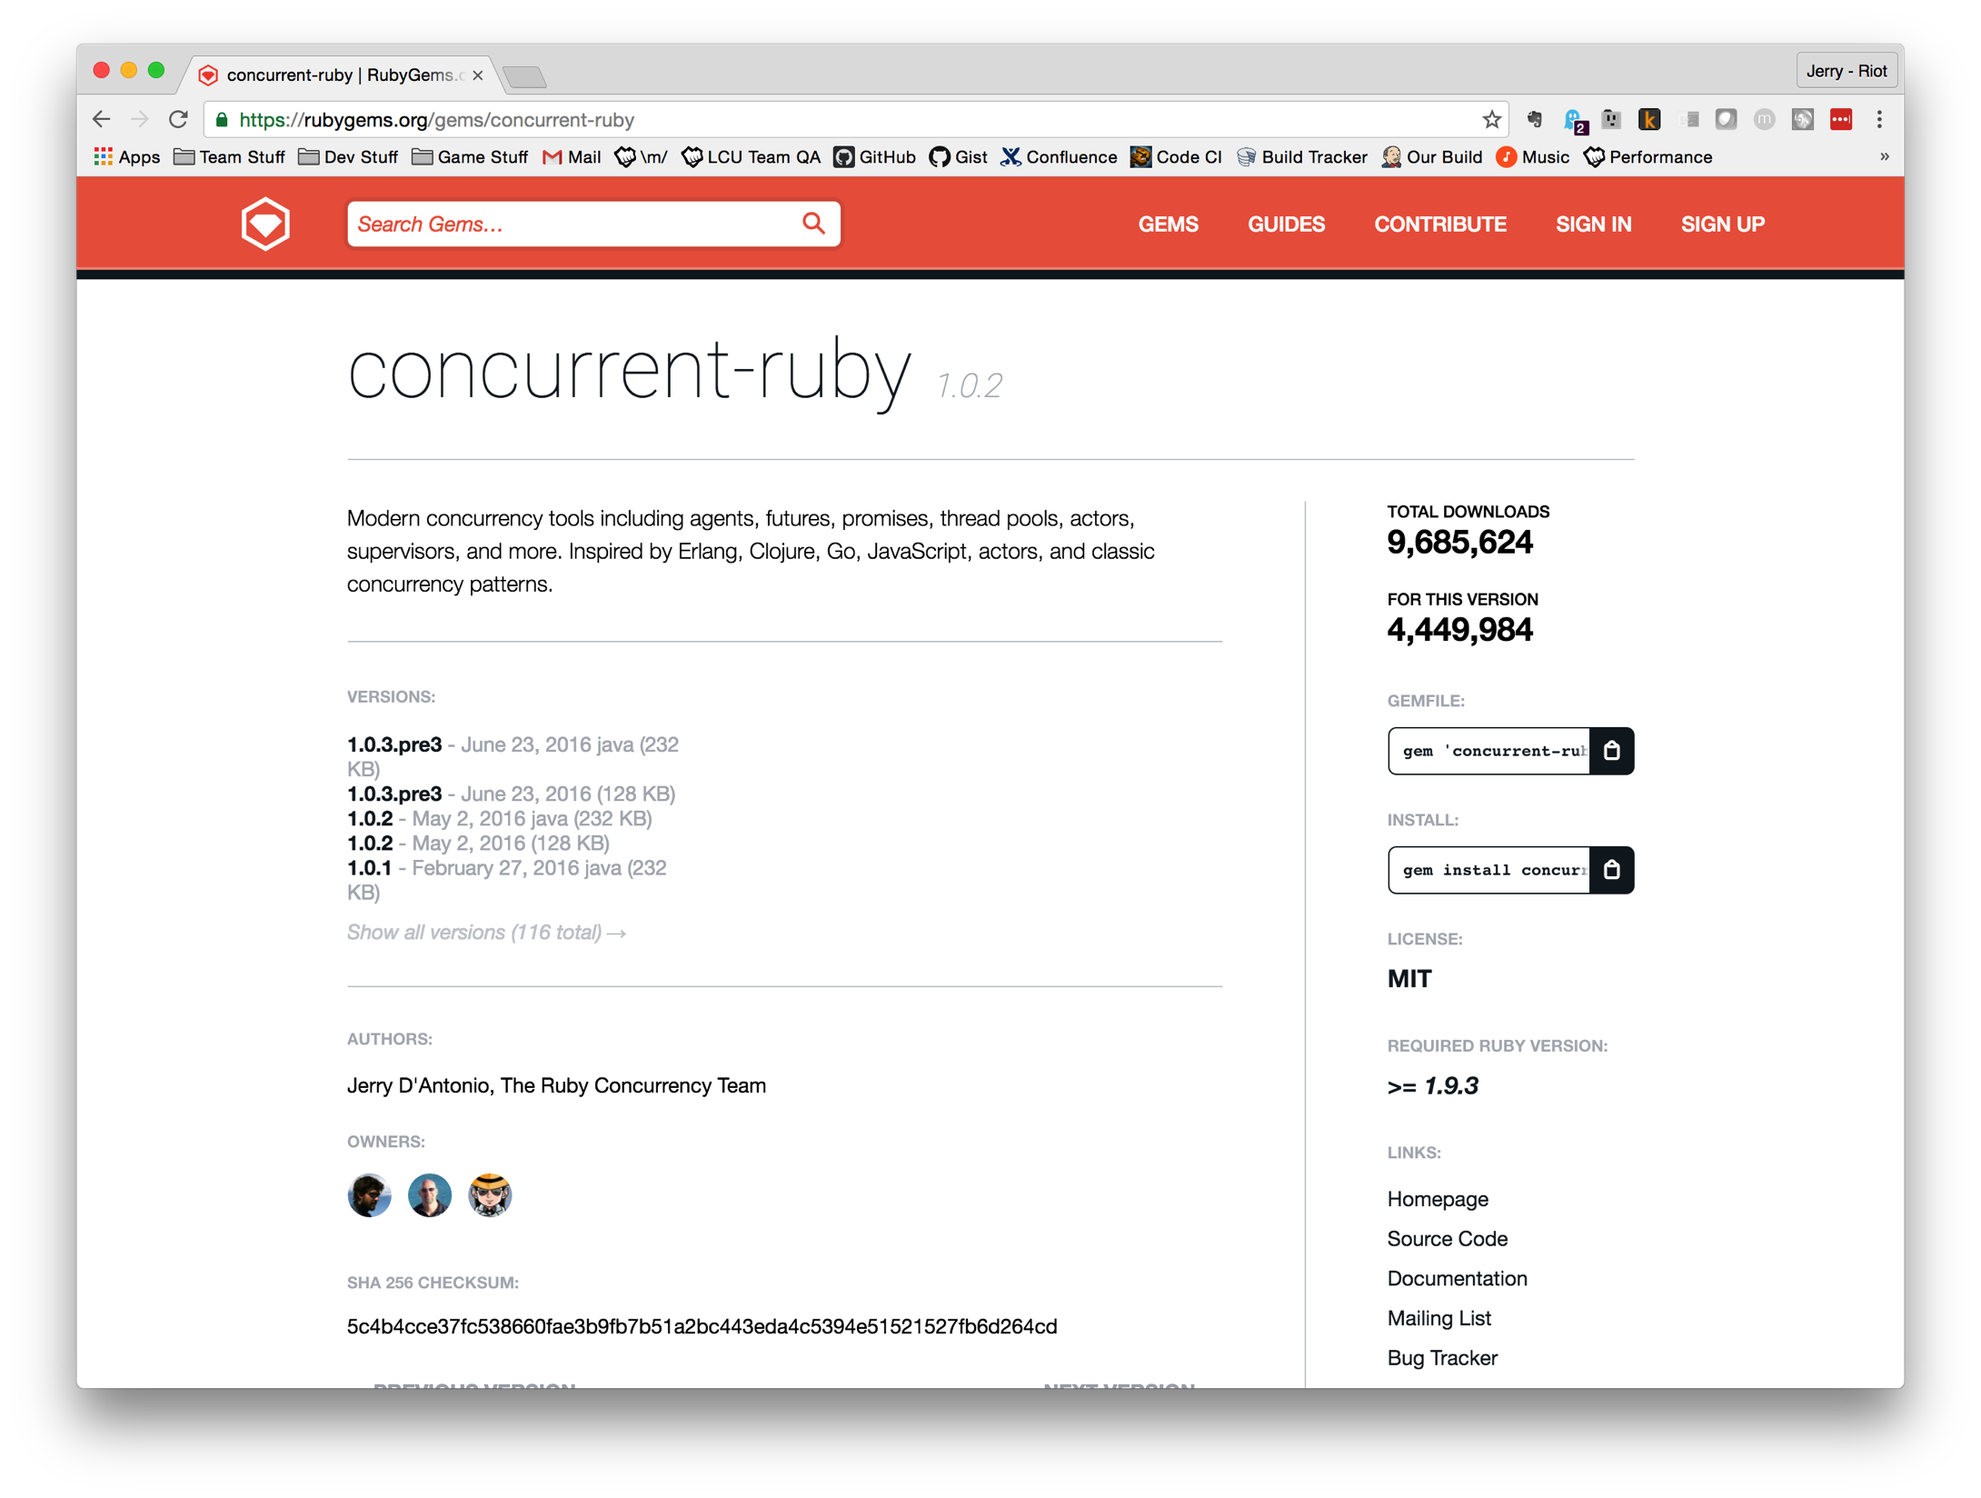

Slide 19
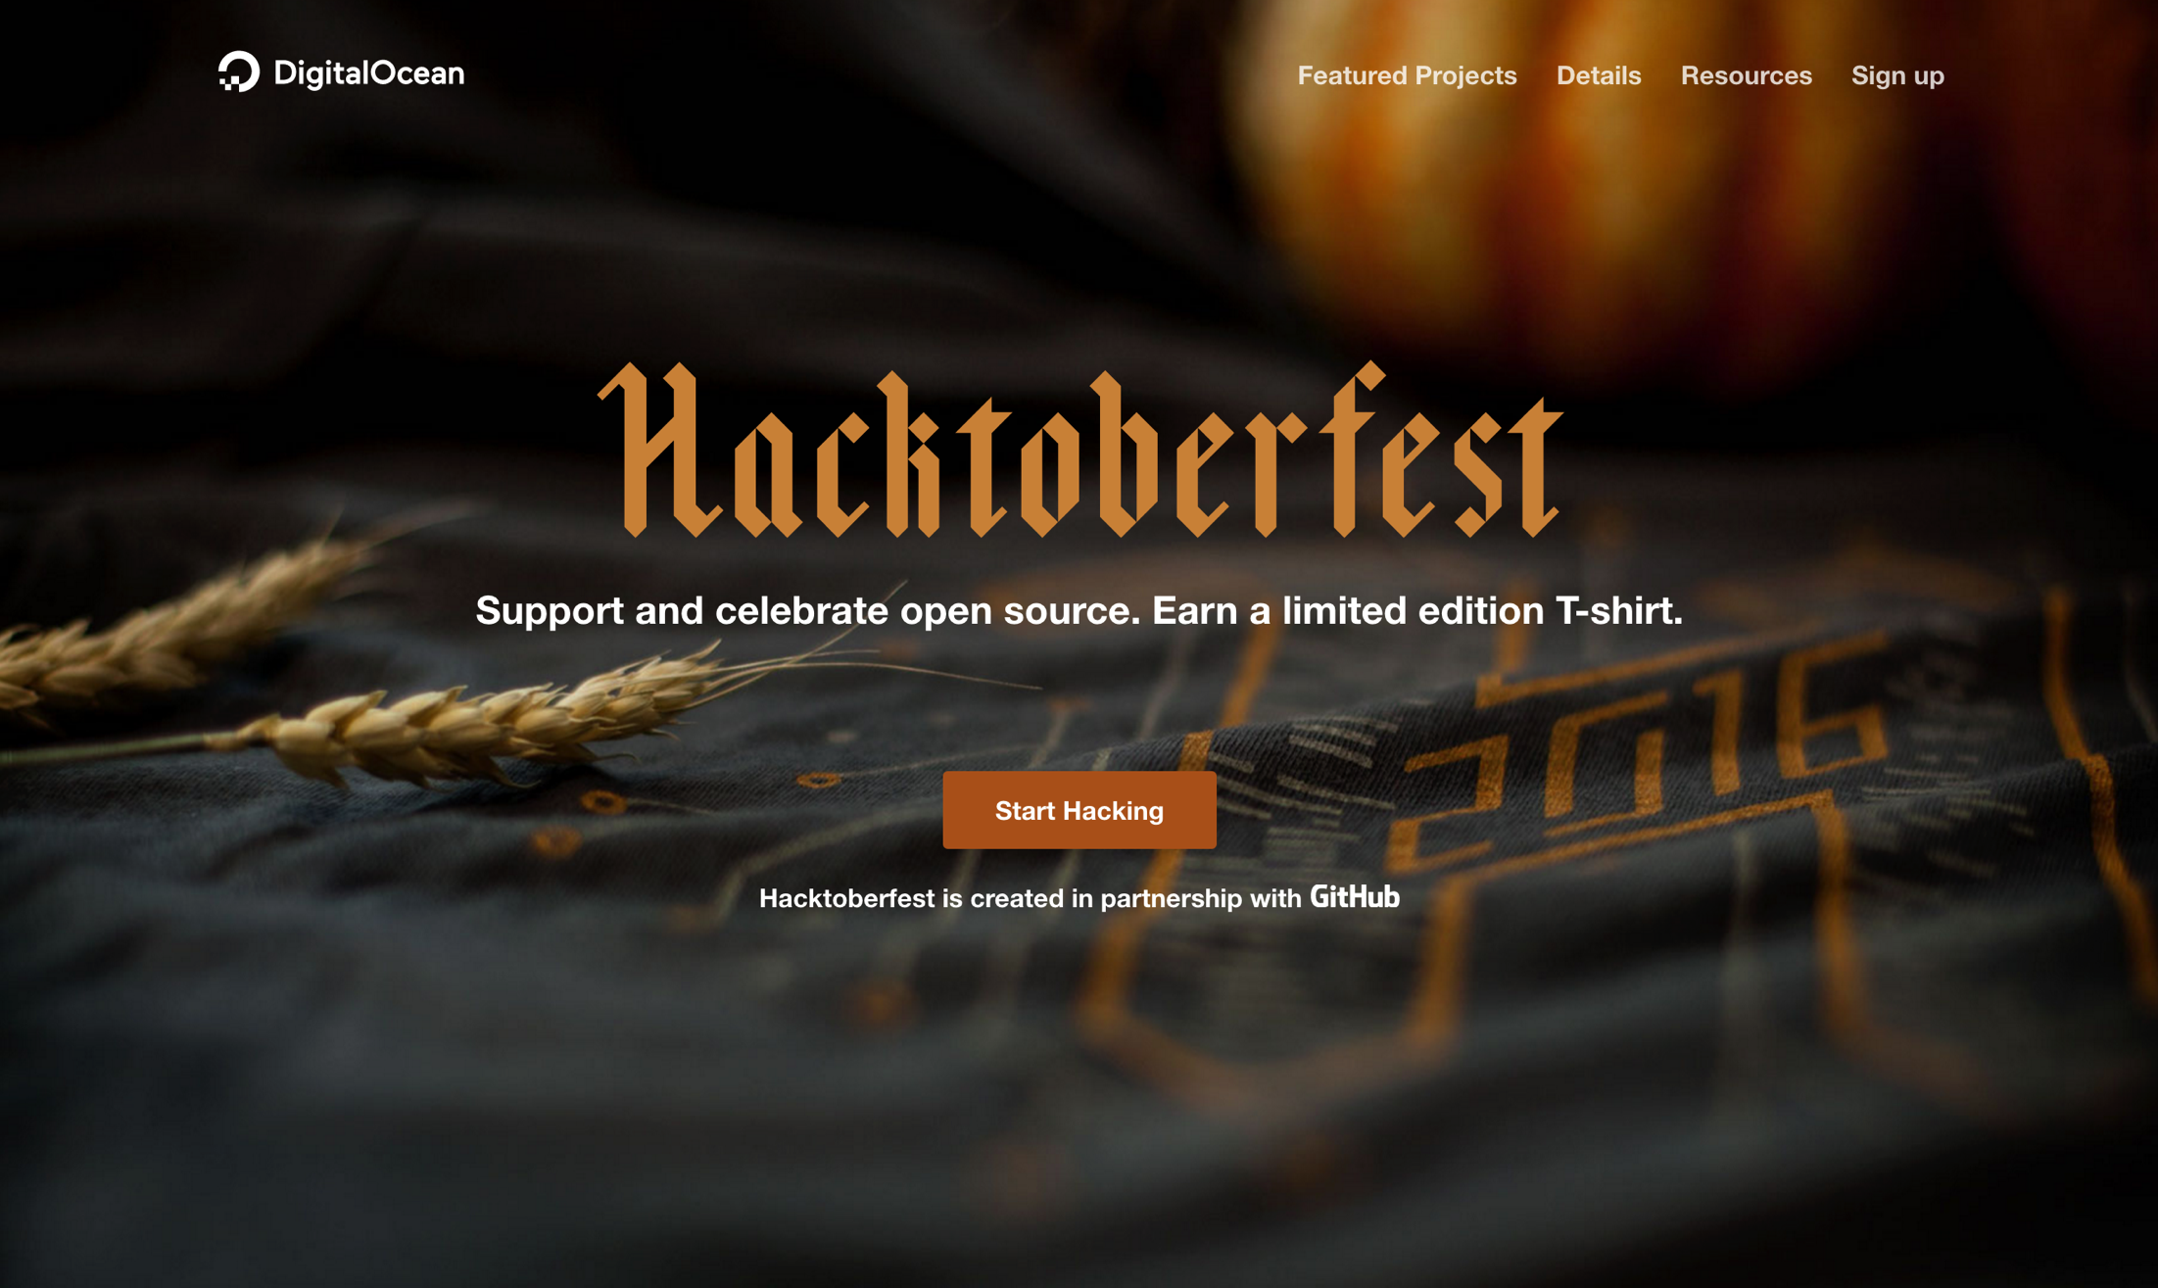

Slide 20
Ways to Contribute
Documentation
Bug/issue lists
Test coverage
Create new projects
Take over fallow projects

Slide 21
Open Source Etiquette
Follow the published rules
Adopt their style
Be polite and respectful
Be open to feedback and requested changed
Don't be discouraged if your work isn't accepted

Slide 22
Conferences
Conferences are costly but highly concentrated.

Slide 23
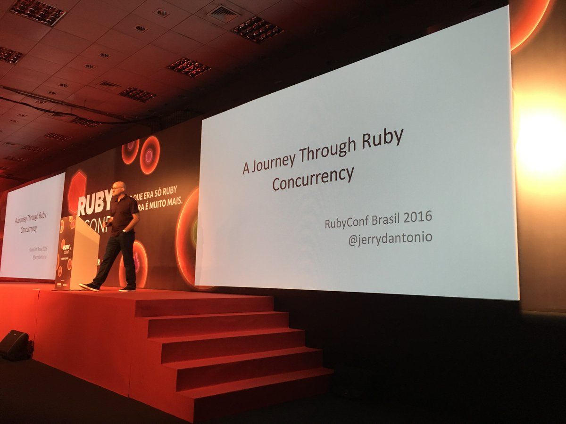

Slide 24
Reasons to Attend Conferences
Professional networking
Social networking
Accelerated learning
Hands-on training
Present
Submitted CFP
Lightning talk
Swag
Notes:
## Conferences
Conferences are costly but highly concentrated. Done right there can be a very high ROI.
Reasons to attend:
* Professional networking
* Social networking
* Accelerated learning
* Hands-on training
* Present
- Submitted CFP
- Lightning talk
* Swag
Ways to evaluate conference ROI:
* How much will in cost (ticket, travel, lodging, food, etc.)?
* How unique is the content?
* Will the sessions be recorded and available later?
* Will you take advantage of the networking opportunities?
A few local and regional conference opportunities:
https://www.eventbrite.com/d/oh--columbus/tech-conference/
* Stir Trek
* CodeMash
* PyOhio
* Steel City Ruby Conference

Slide 25
Evaluating Conference Value
How much will in cost (ticket, travel, lodging, food, etc.)?
How unique is the content?
Will the sessions be recorded and available later?
Will you take advantage of the networking opportunities?

Slide 26
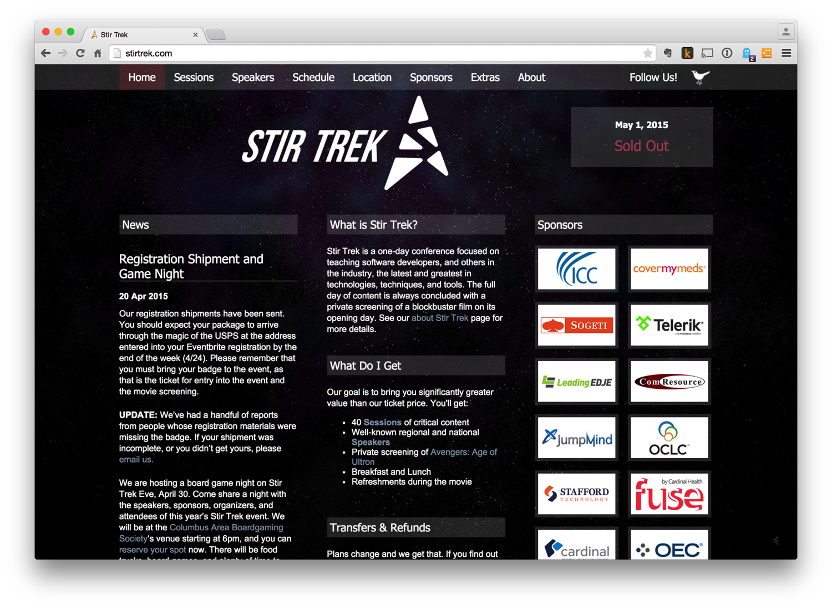

Slide 27
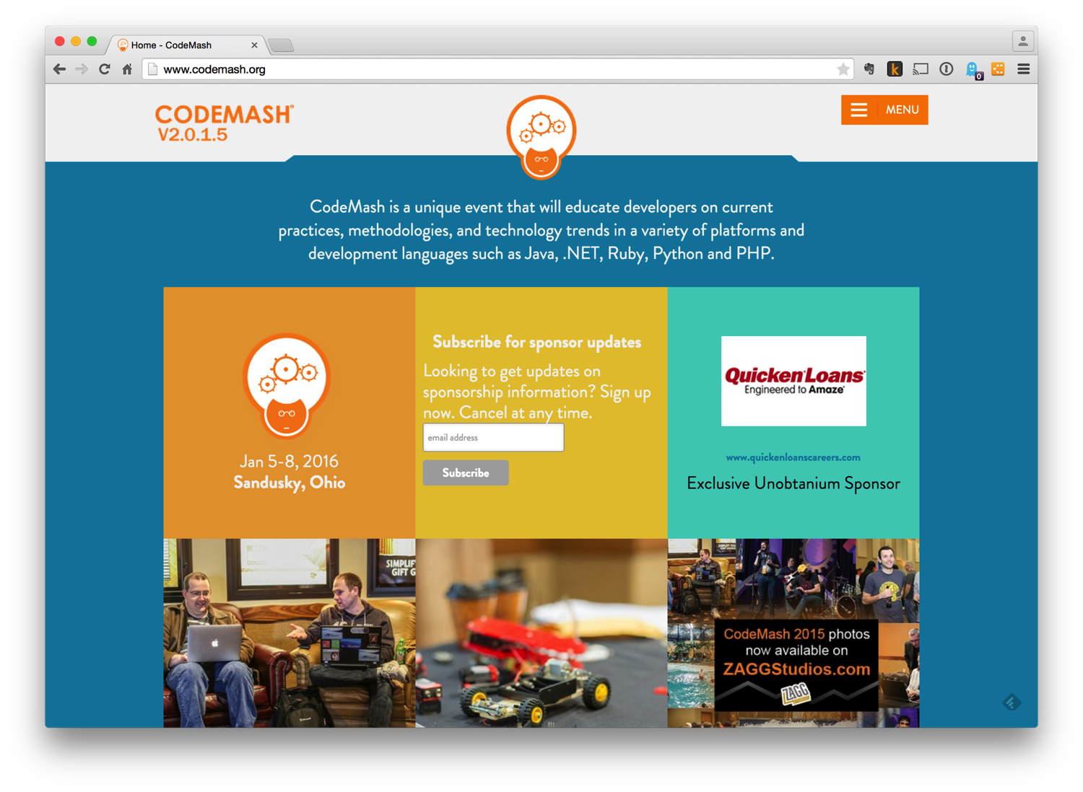

Slide 28
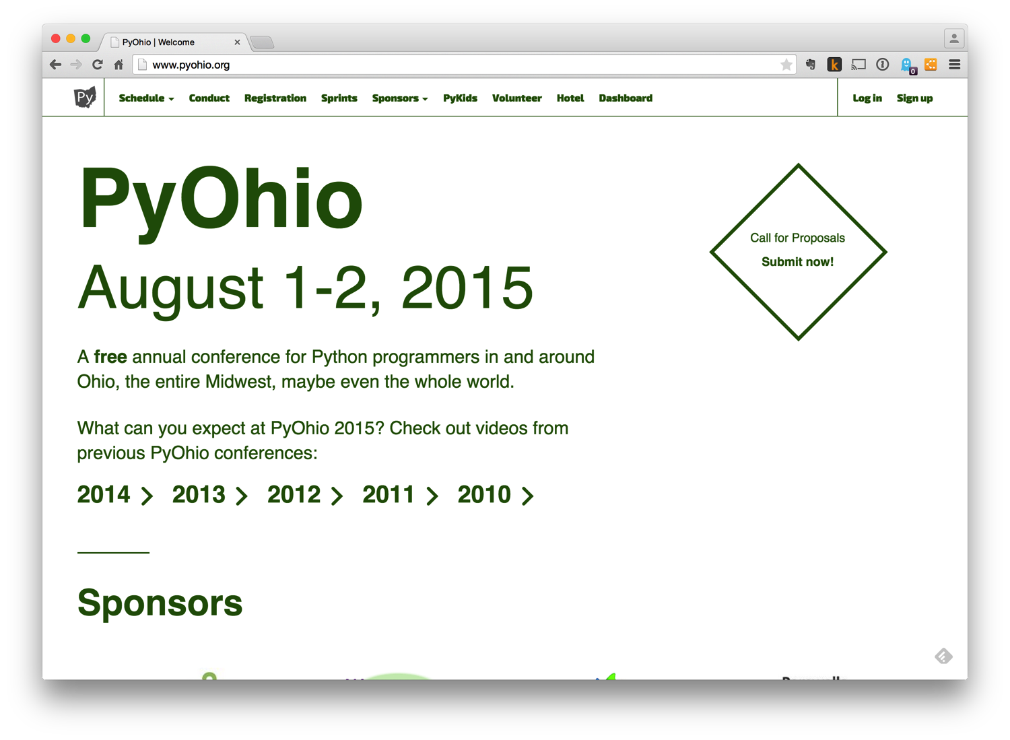

Slide 29
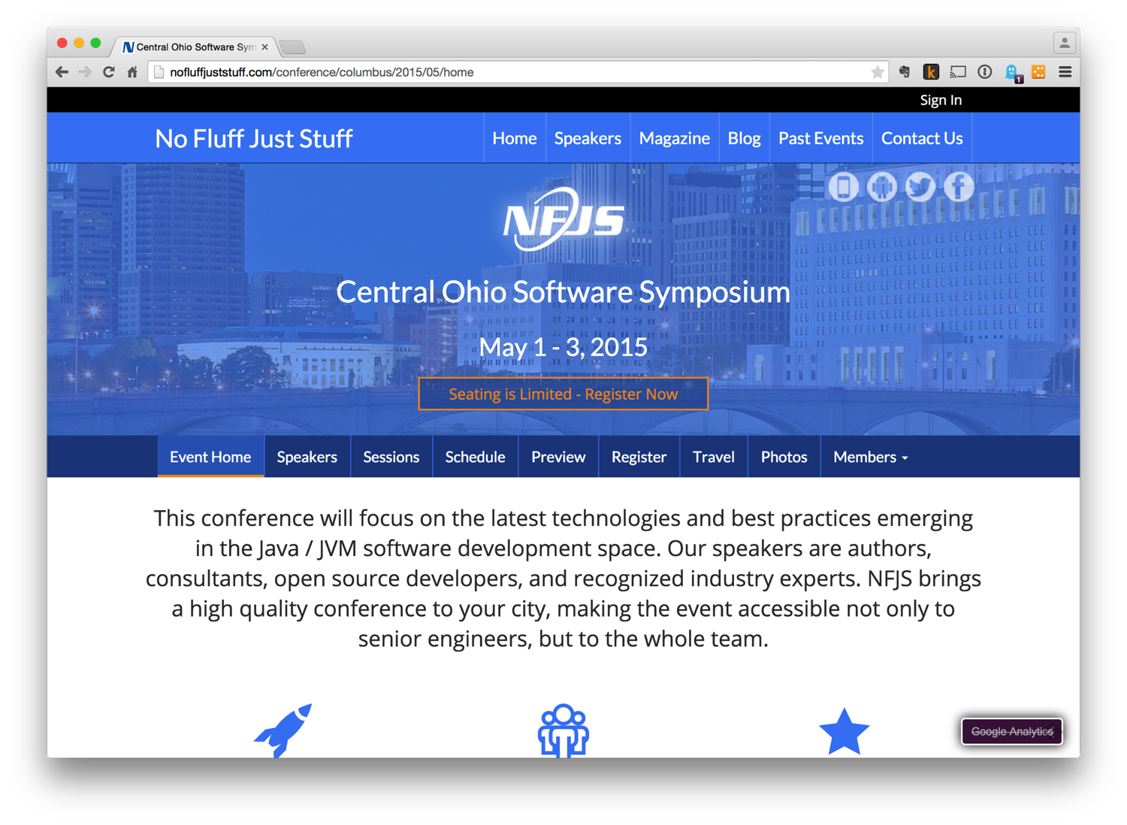

Slide 30
Meetup Groups
“neighbors getting together to learn something, do something, share something…” – Meetup.com

Slide 31
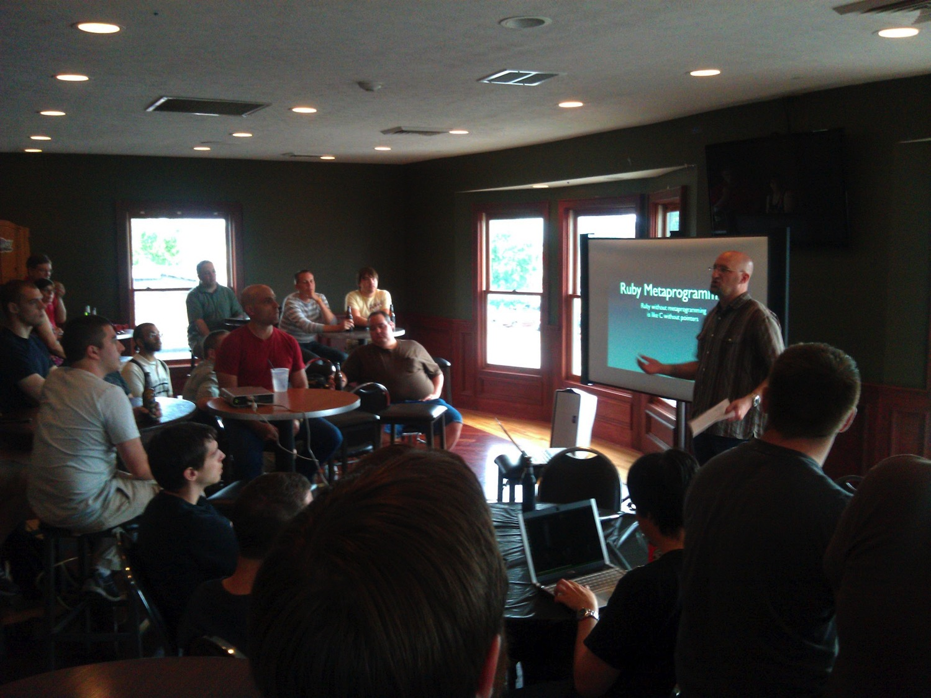

Slide 32
Reasons to Join Meetup Groups
Professional networking
Social networking
Learn cool new stuff
Gain more experience
Work with talented, experienced developers
Notes:
## Meetup Groups
Reasons to join meetup groups:
* Professional networking
* Social networking
* Learn cool new stuff
* Gain more experience
* Work with talented, experienced developers
A few local meetup groups:
http://clevelandtechevents.com/
* Akron Code Club
* Akron Women in Tech
* Hudson Software Craftsmanship
* And many more...

Slide 33
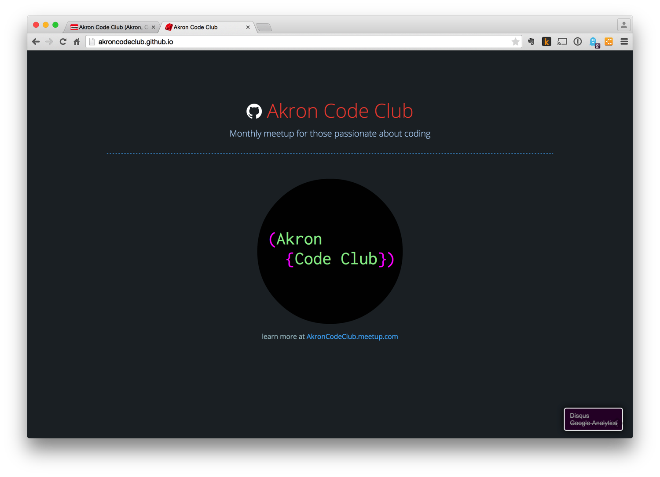

Slide 34
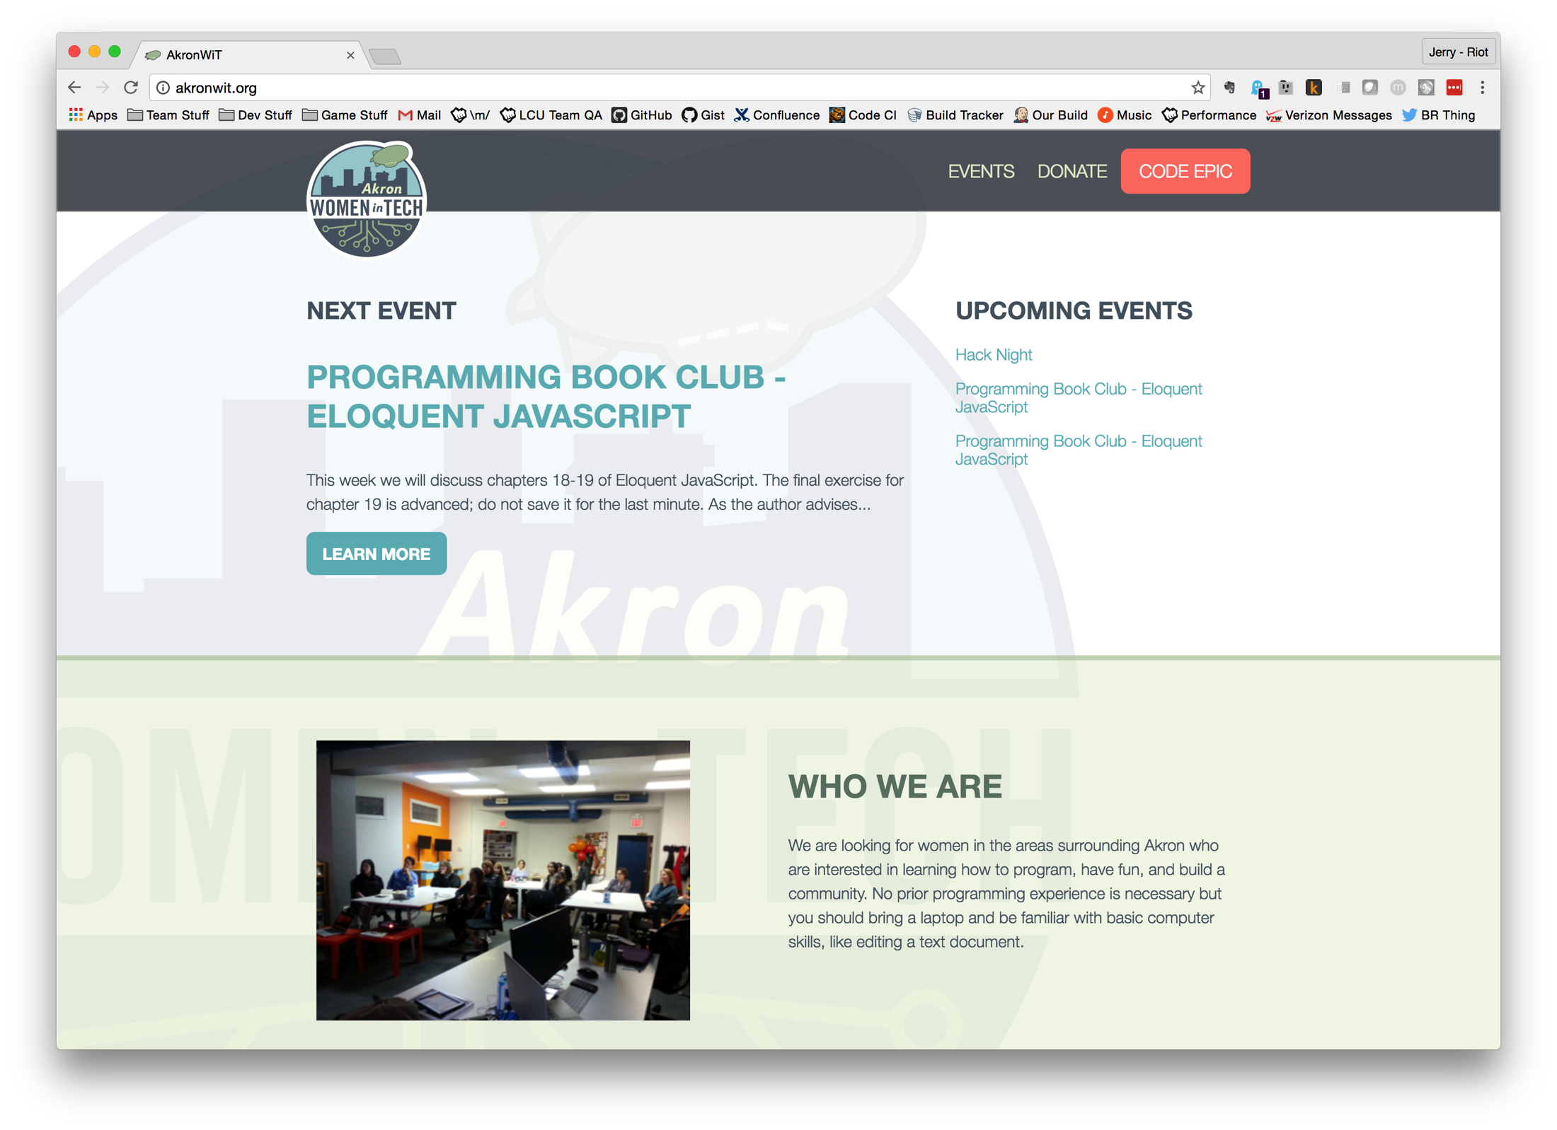

Slide 35
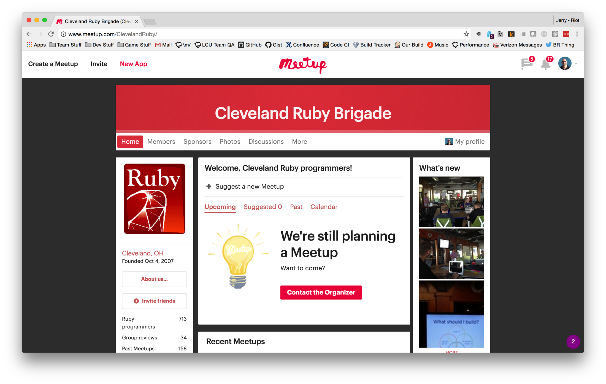

Slide 36
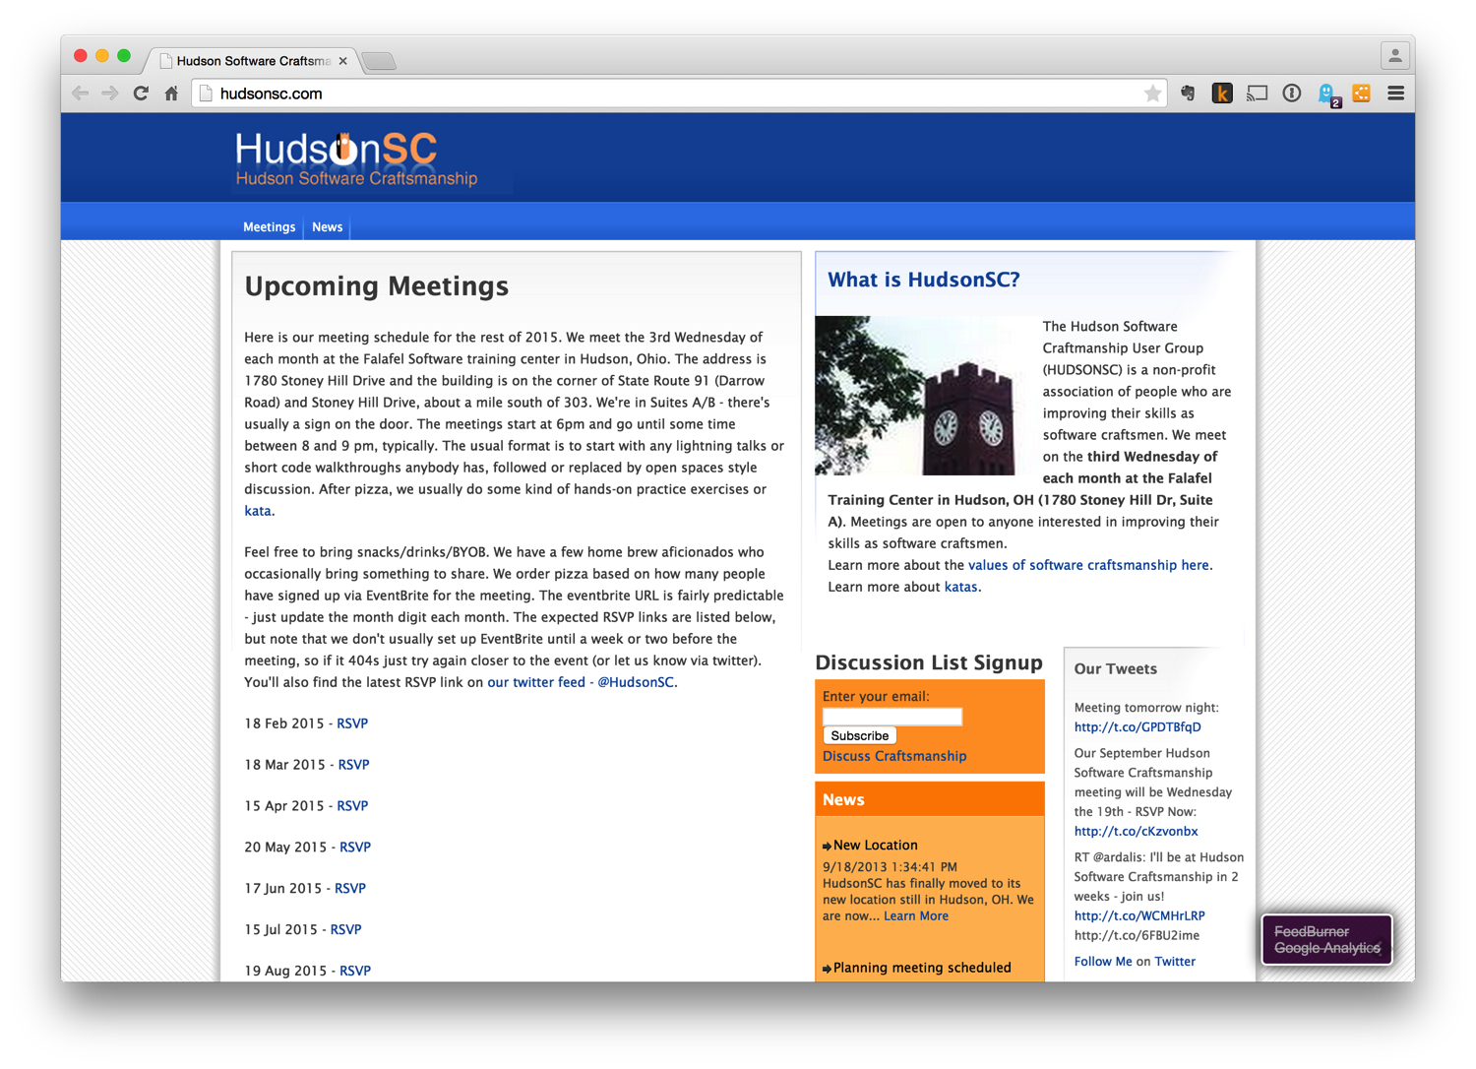

Slide 37
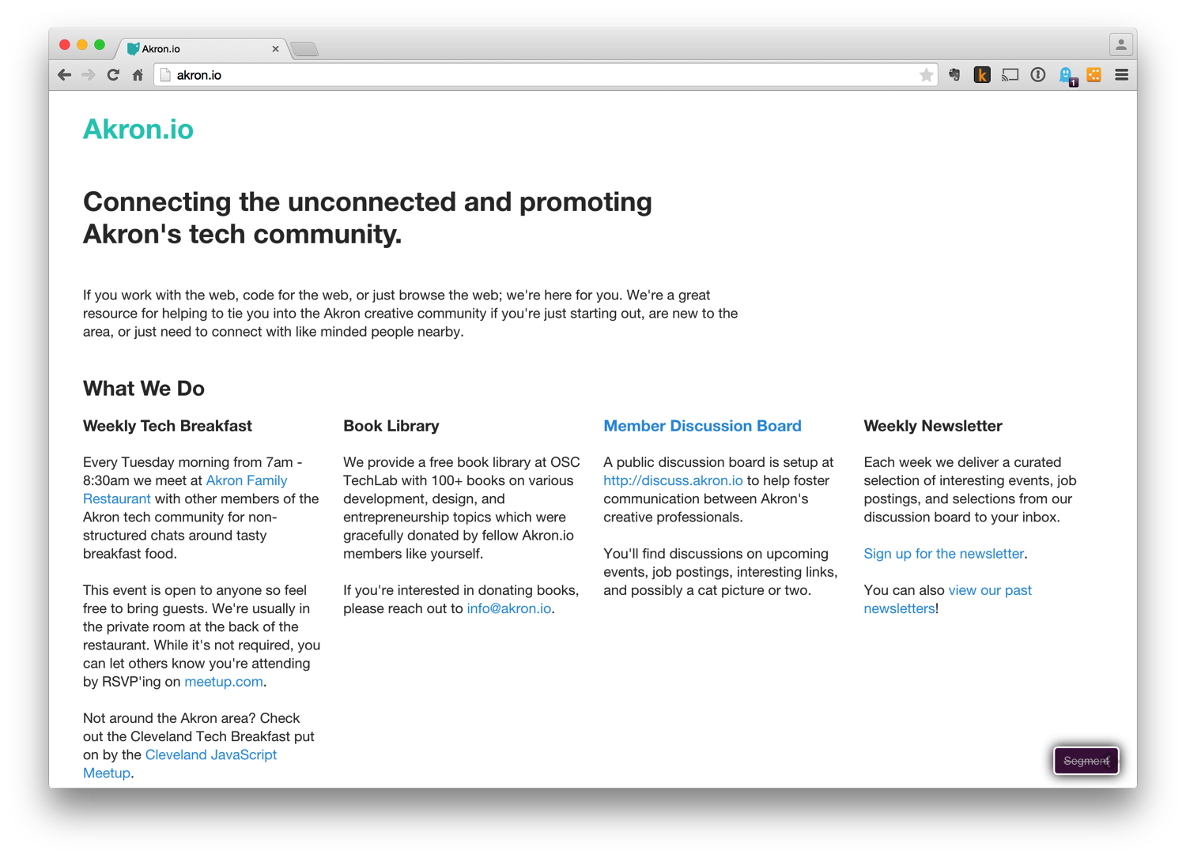

Slide 38
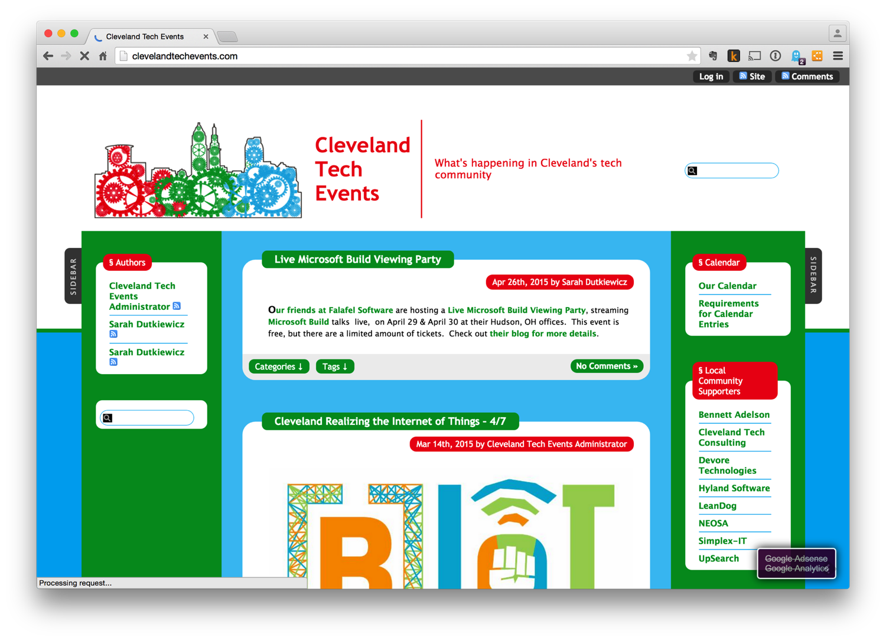

Slide 39
Hackerspaces
"If you build it, he will come” – Field of Dreams

Slide 40
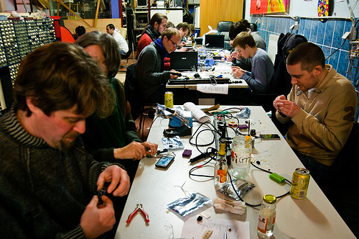

Slide 41
A Place of My Own
Hackerspace: "A hackerspace (also referred to as a hacklab, makerspace or hackspace) is a community-operated workspace where people with common interests, often in computers, machining, technology, science, digital art or electronic art, can meet, socialize and collaborate.”
Coworking: "Coworking is a style of work that involves a shared working environment, often an office, and independent activity.”
-- Wikipedia
Notes:
## Hackerspaces
Wikipedia Definitions:
* Hackerspace: "A hackerspace (also referred to as a hacklab, makerspace or hackspace) is a community-operated workspace where people with common interests, often in computers, machining, technology, science, digital art or electronic art, can meet, socialize and collaborate."
* Coworking: "Coworking is a style of work that involves a shared working environment, often an office, and independent activity."
A few local places:
* synHAK
* Makers' Alliance
* OSC Tech Lab

Slide 42
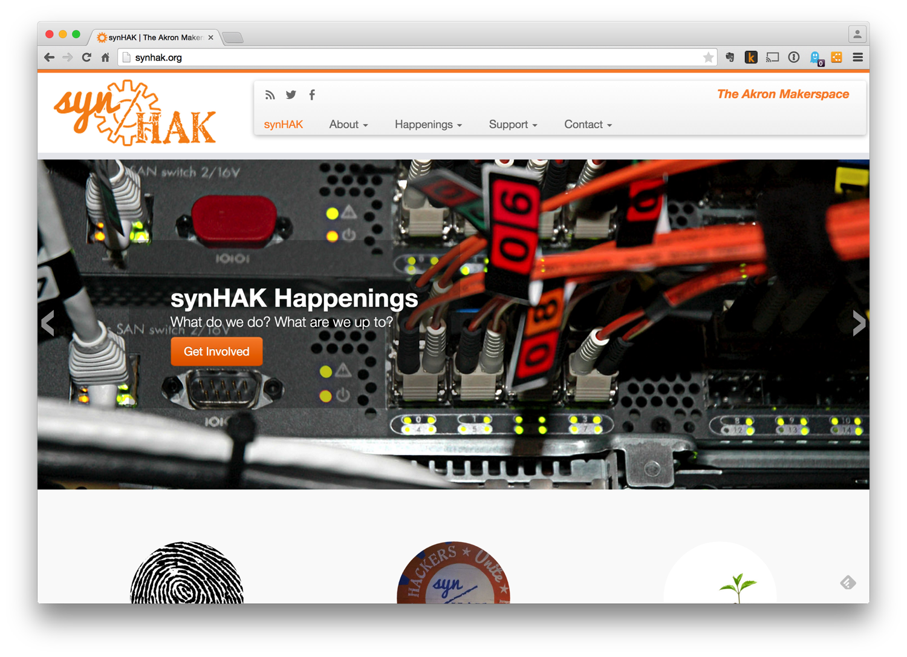

Slide 43
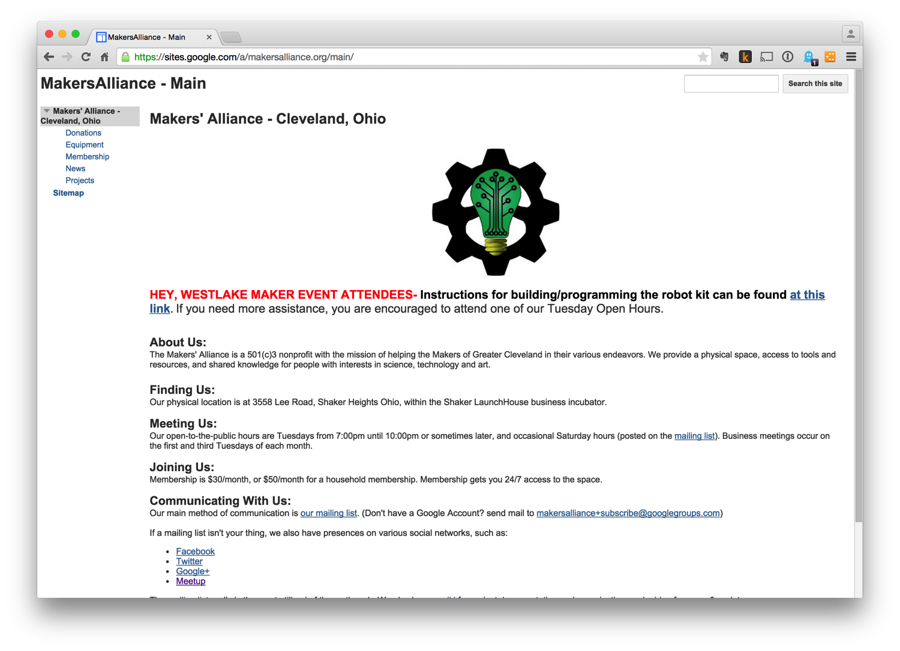

Slide 44
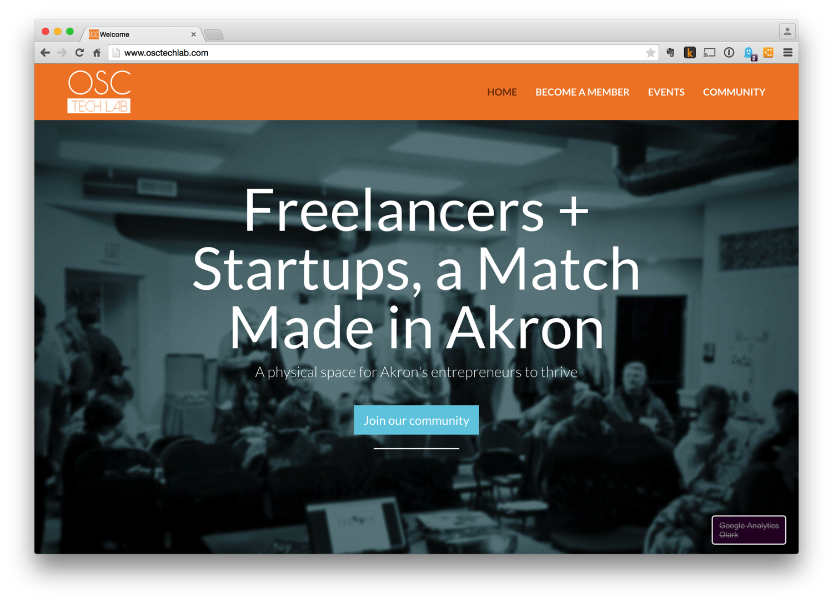

Slide 45
Hackathon

Slide 46
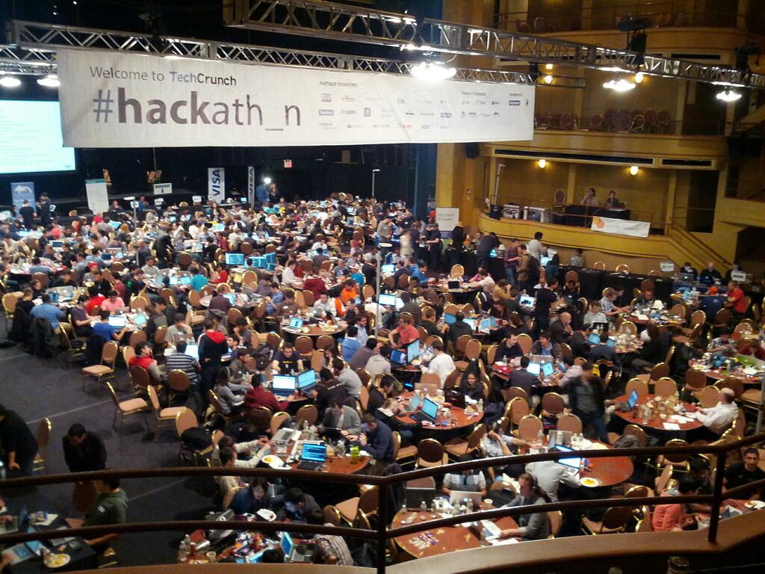

Slide 47
What is a Hackathon?
A hackathon (also known as a hack day, hackfest or codefest) is an event in which computer programmers and others involved in software development and hardware development, including graphic designers, interface designers and project managers, collaborate intensively on software projects.”
-- Wikipedia
Notes:
## Hackathons
What are they?
From Wikipedia: *"A hackathon (also known as a hack day, hackfest or codefest) is an event in which computer programmers and others involved in software development and hardware development, including graphic designers, interface designers and project managers, collaborate intensively on software projects."*
* Single or multi-day intensive programming event
* One or more teams working in coordination
* Focus of the event is pre-defined
* Teams for around event focus and race to build functional prototype
* One or more teams is often declared the "winner" of the event
Benefits of attending hackathons:
* Professional and social networking
* Intensive learning experience
* Generally involve really cool problems
* Often result in giving back to open source or civic good
A few regional hackathons:
* SpaceApps
* Cleveland Givecamp
* Railsbridge
* Startup Weekend
* Startup Bus
* Coderetreat
* Erie Day of Code

Slide 48
What is a Hackathon?
Single or multi-day intensive programming event
One or more teams working in coordination
Focus of the event is pre-defined
Teams for around event focus and race to build functional prototype
One or more teams is often declared the "winner" of the event

Slide 49
What’s Cool About Hackathons
Professional and social networking
Intensive learning experience
Generally involve really cool problems
Often result in giving back to open source or civic good
Sometimes even start a new business

Slide 50
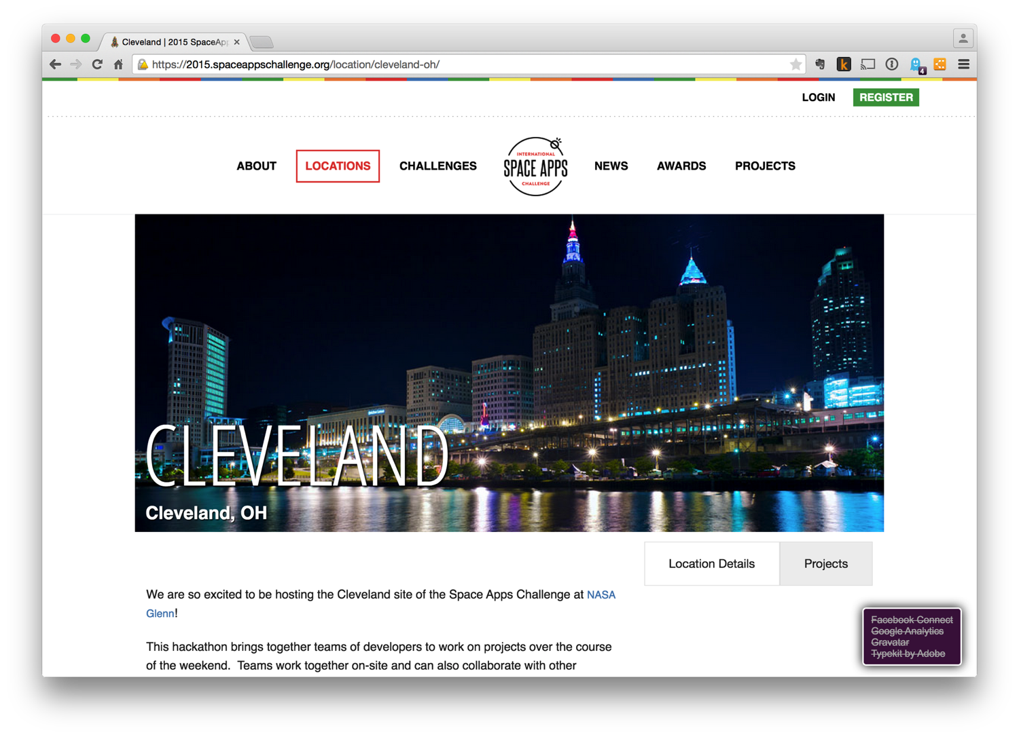

Slide 51
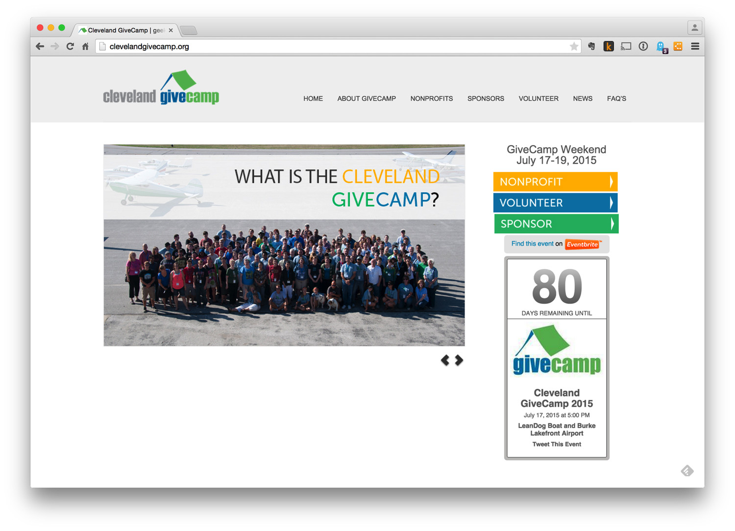

Slide 52
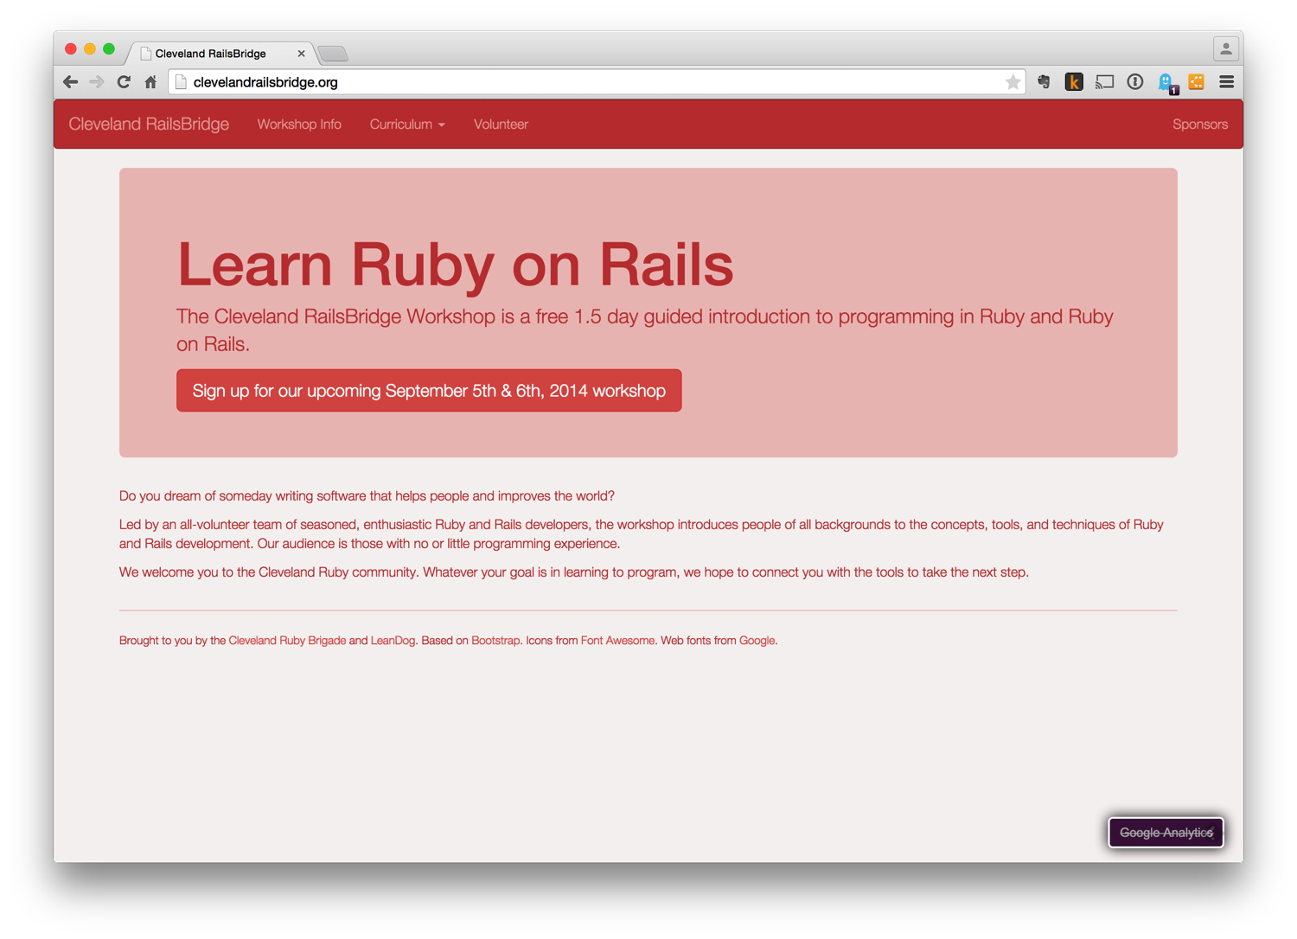

Slide 53
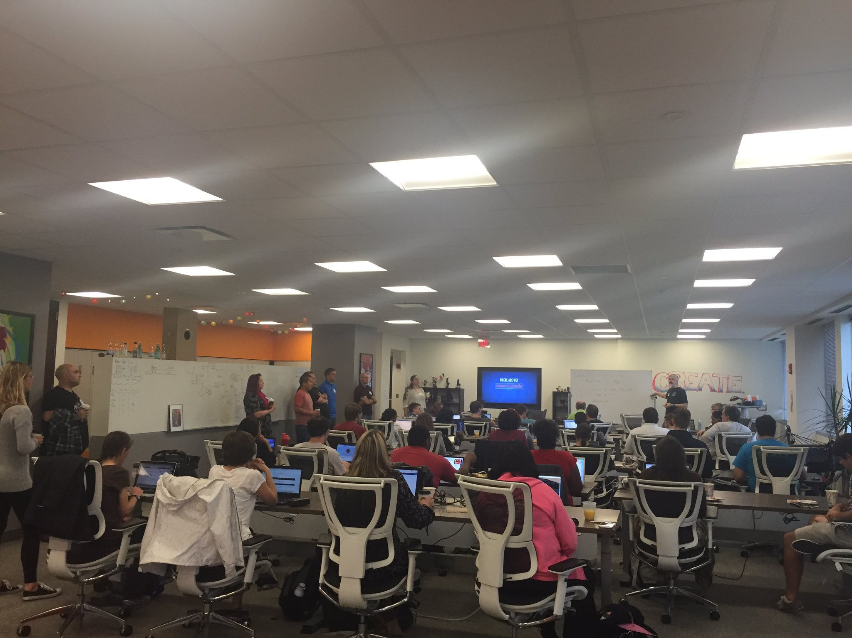
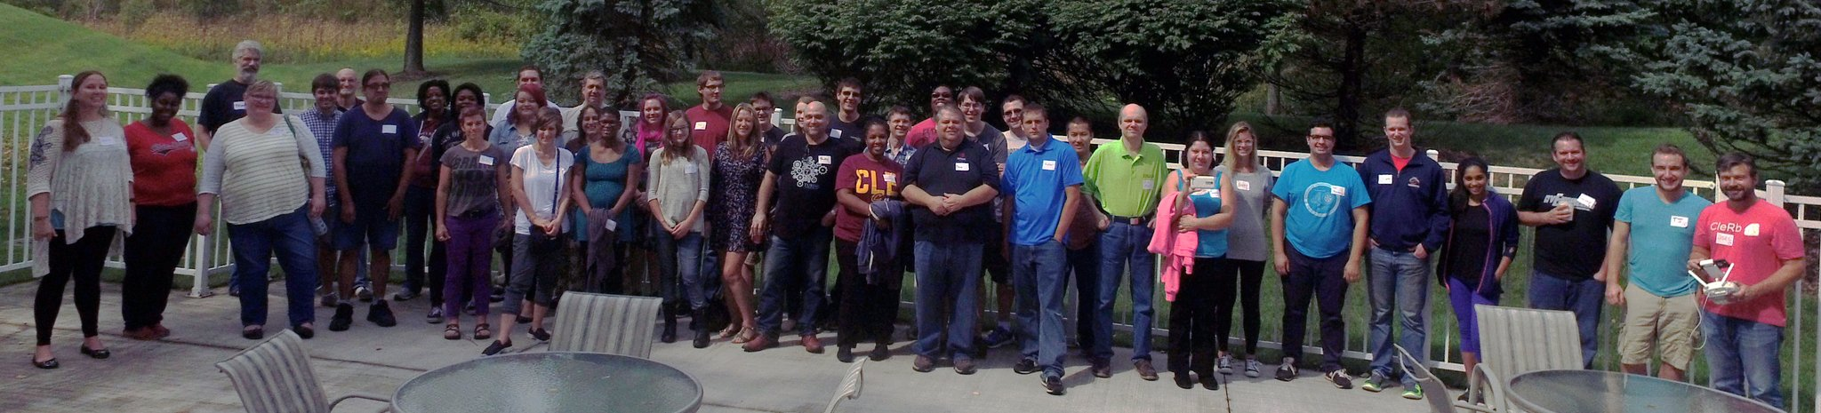

Slide 54
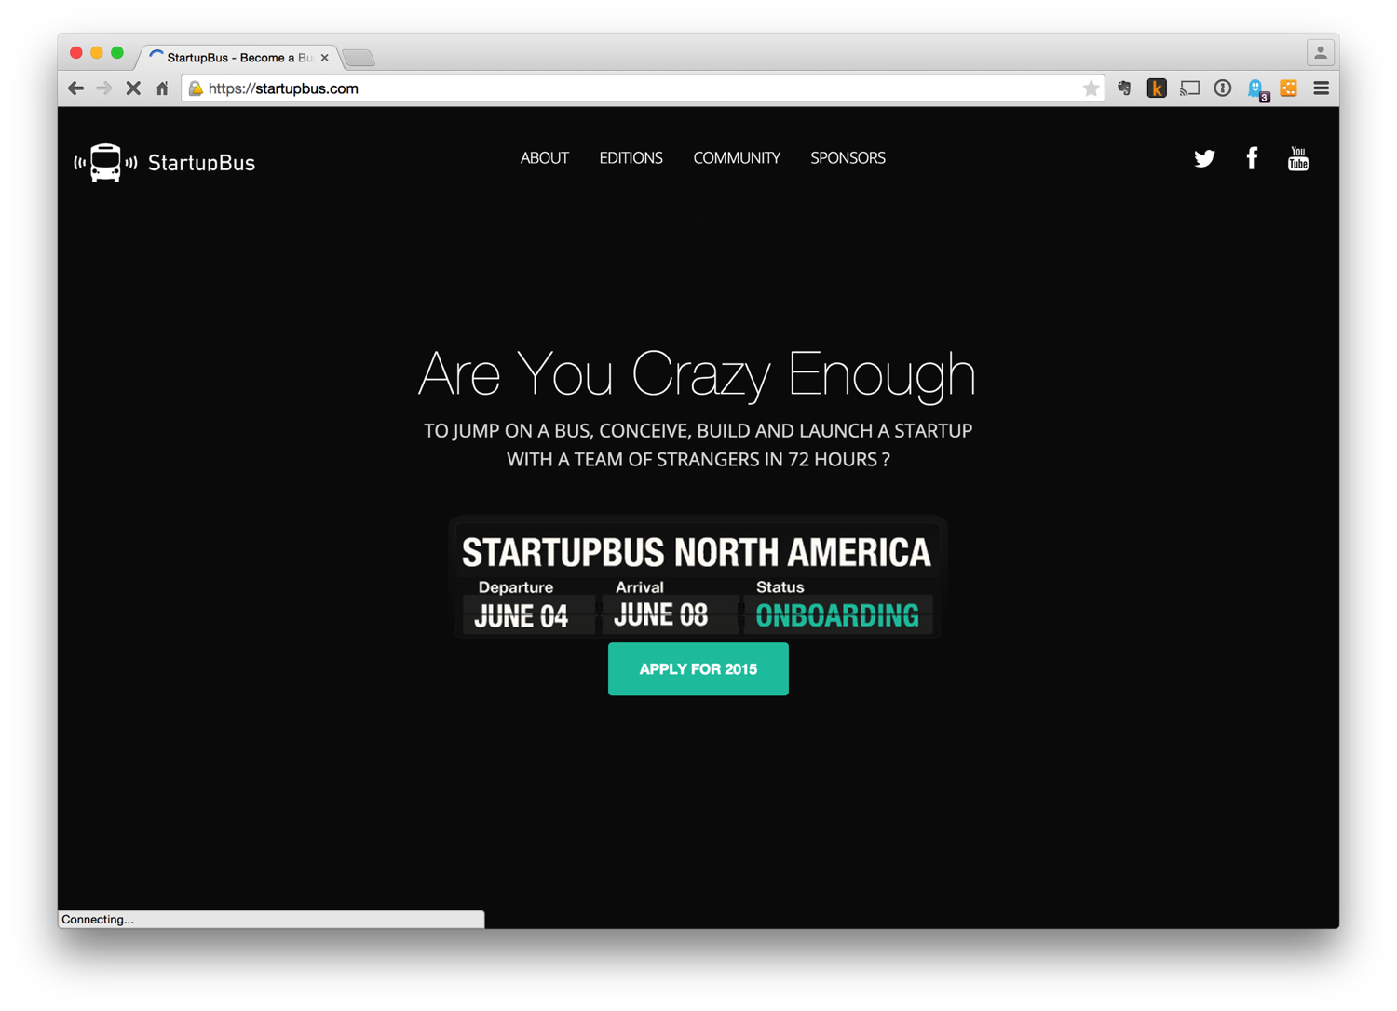

Slide 55
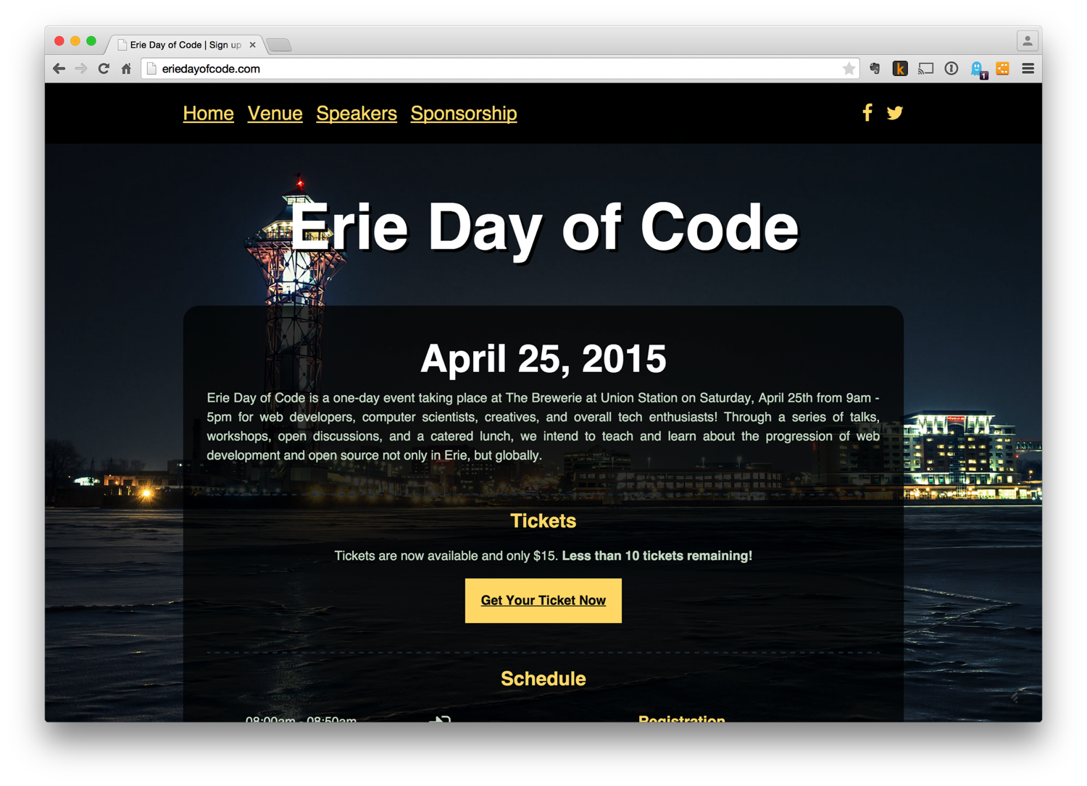

Slide 56
Civic Hacking
“We have to make bureaucracy sexy.” -- Jennifer Pahlka

Slide 57
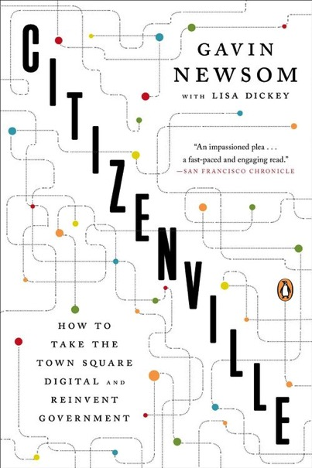
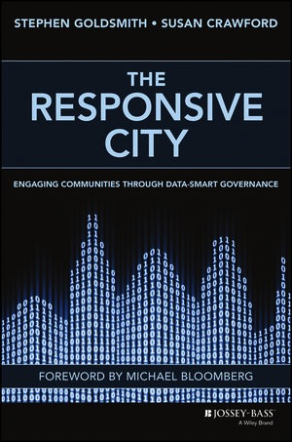
A New Form of Governance

Slide 58
Civic Hacking
“A civic hacker is an open source software developer who uses his or her skills to make their community and country a better place. ... A civic hacker will just do something, not asking for permission, ignoring government bureaucracy, in order to build tools and technologies with a civic-minded bent.”
-- Luigi Montanez
Notes:
## Civic Hacking
*"A civic hacker is an open source software developer who uses his or her skills to make their community and country a better place. ... A civic hacker will just do something, not asking for permission, ignoring government bureaucracy, in order to build tools and technologies with a civic-minded bent." -- Luigi Montanez*
Books:
* "Citizenville: How to Take the Town Square Digital and Reinvent Government" by Gavin Newsom
* "The Responsive City: Engaging Communities Through Data-Smart Governance" by Stephen Goldsmith and Susan Crawford
*From Wikipedia: "Open data is the idea that certain data should be freely available to everyone to use and republish as they wish, without restrictions from copyright, patents or other mechanisms of control."*
Benefits of civic hacking:
* Professional and social networking
* Work on cool problems
* Learn new things
* Give back--make the world a better place
Civic hacking and open data organizations and events:
* Open Cleveland
* Cleveland Civic Hacking
* Open Data Cincy
* Code for America
* National Day of Civic Hacking
* Data.gov
* NASA'S Data Portal

Slide 59
Open Data
“Open data is the idea that certain data should be freely available to everyone to use and republish as they wish, without restrictions from copyright, patents or other mechanisms of control.”
-- Wikipedia

Slide 60
Benefits of Civic Hacking
Professional and social networking
Work on cool problems
Learn new things
Give back--make the world a better place

Slide 61
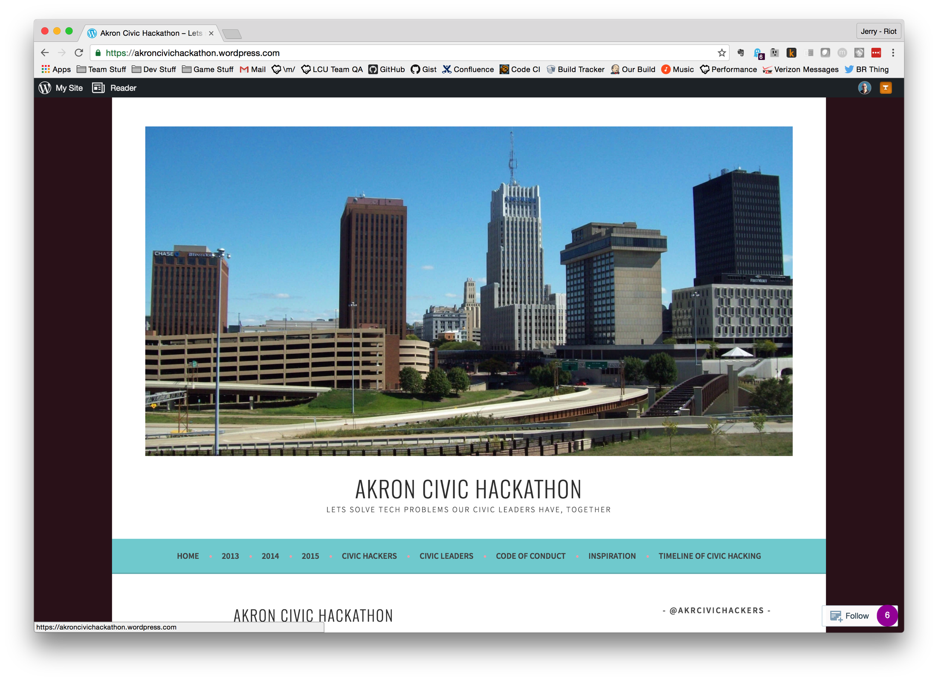

Slide 62
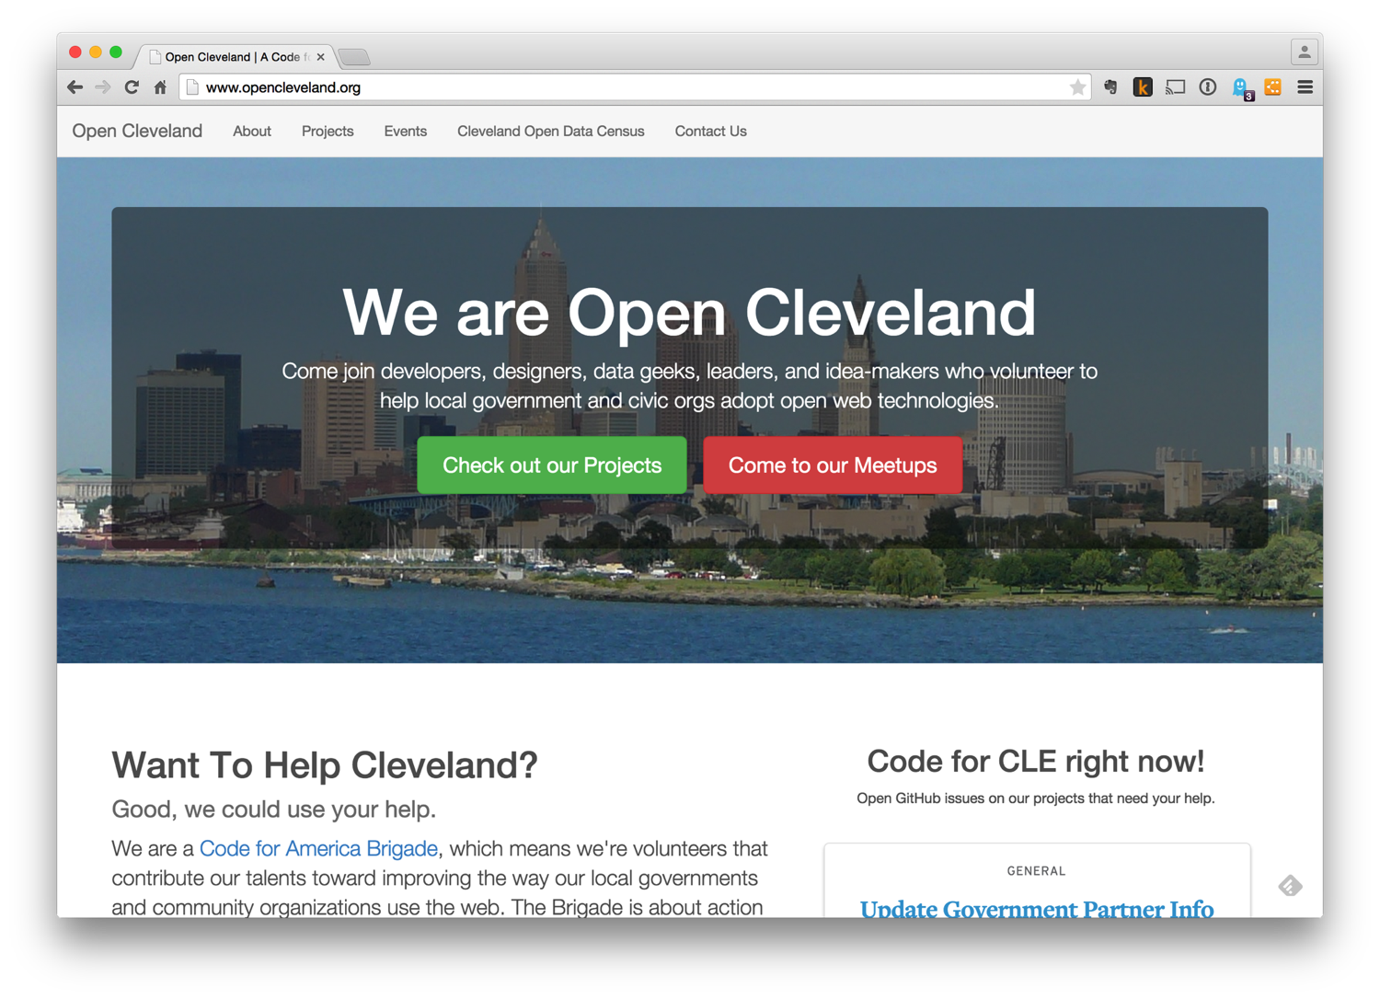

Slide 63
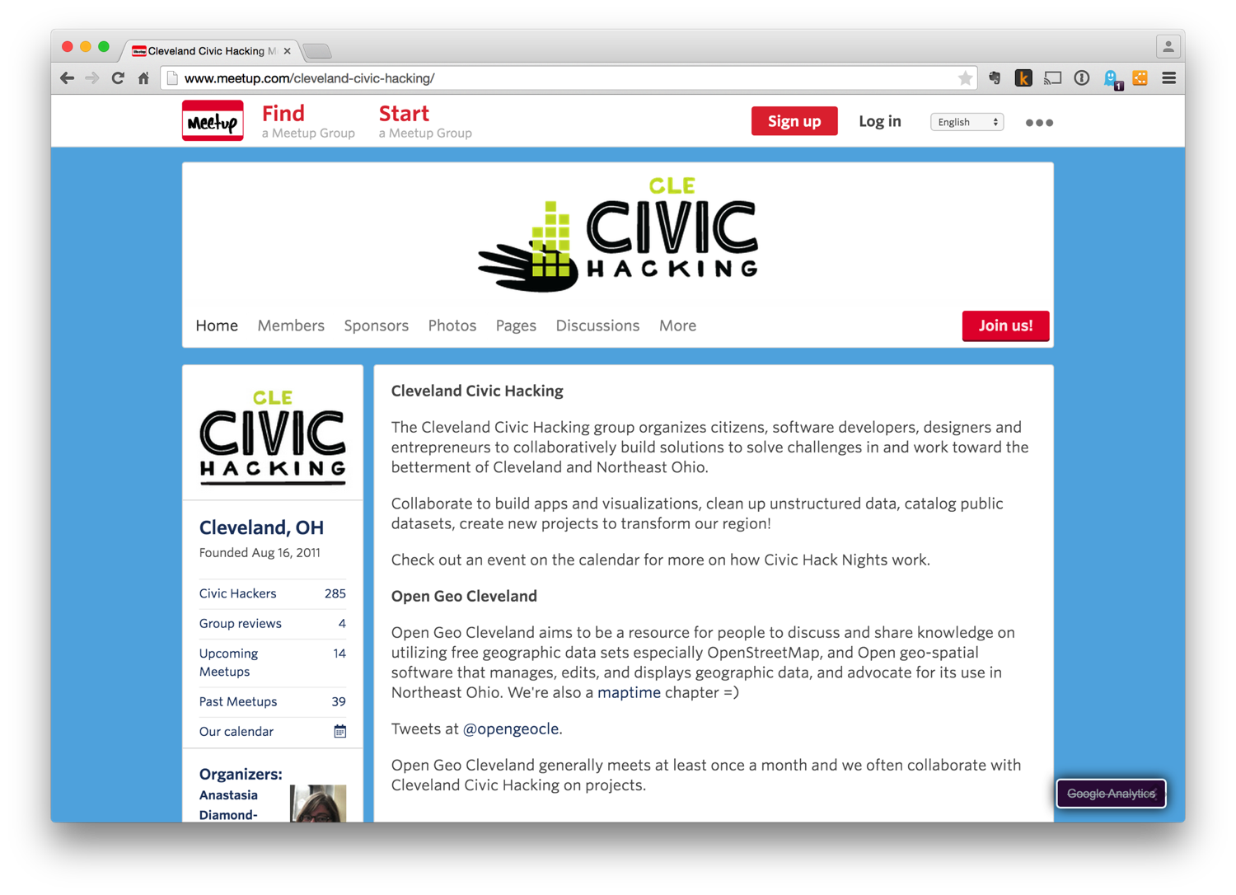

Slide 64
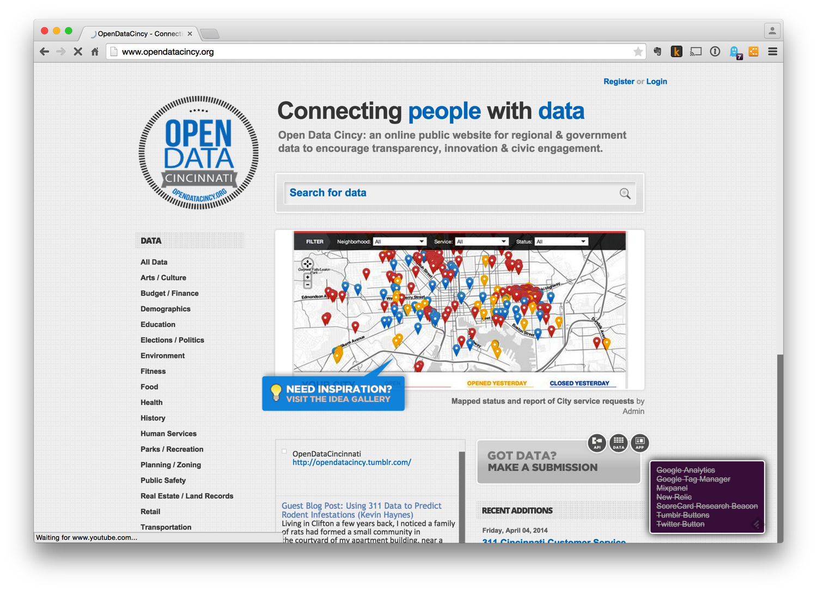

Slide 65
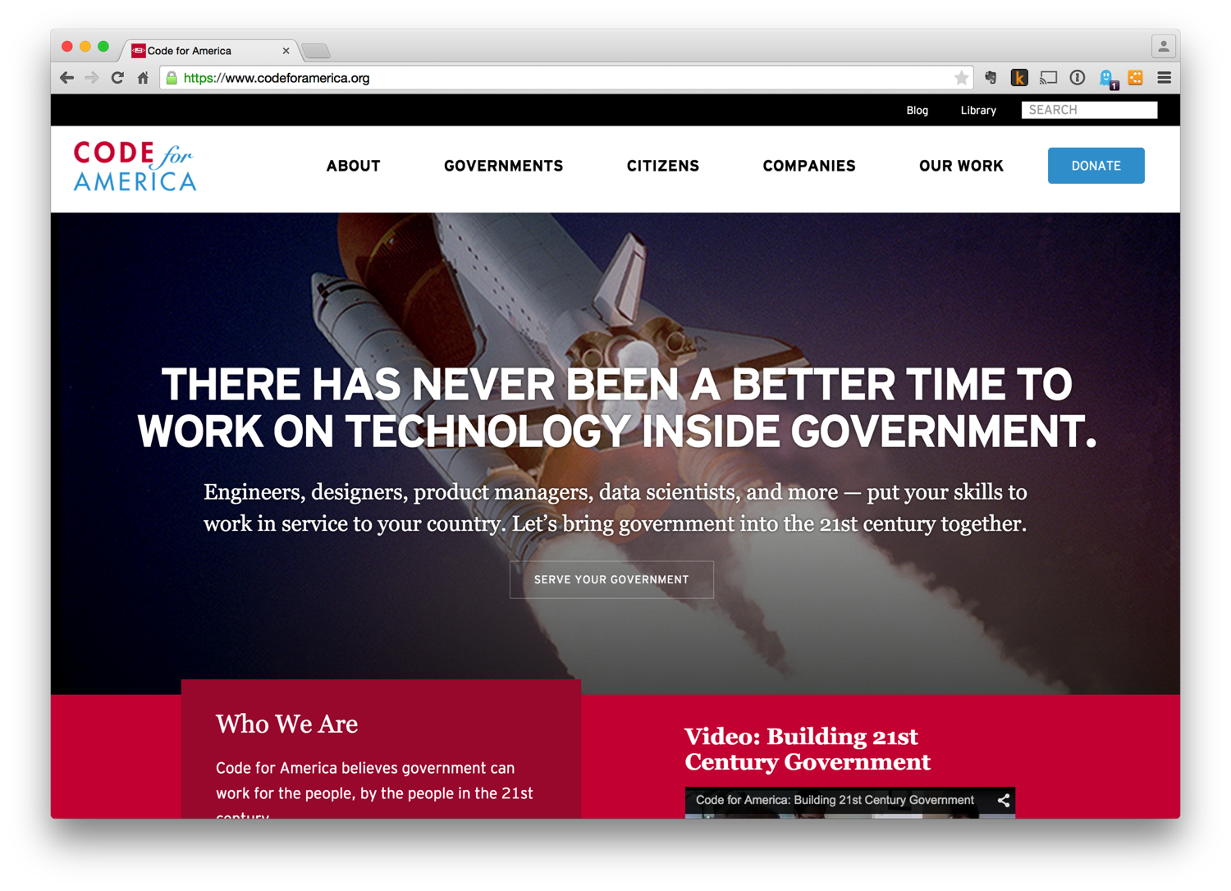

Slide 66
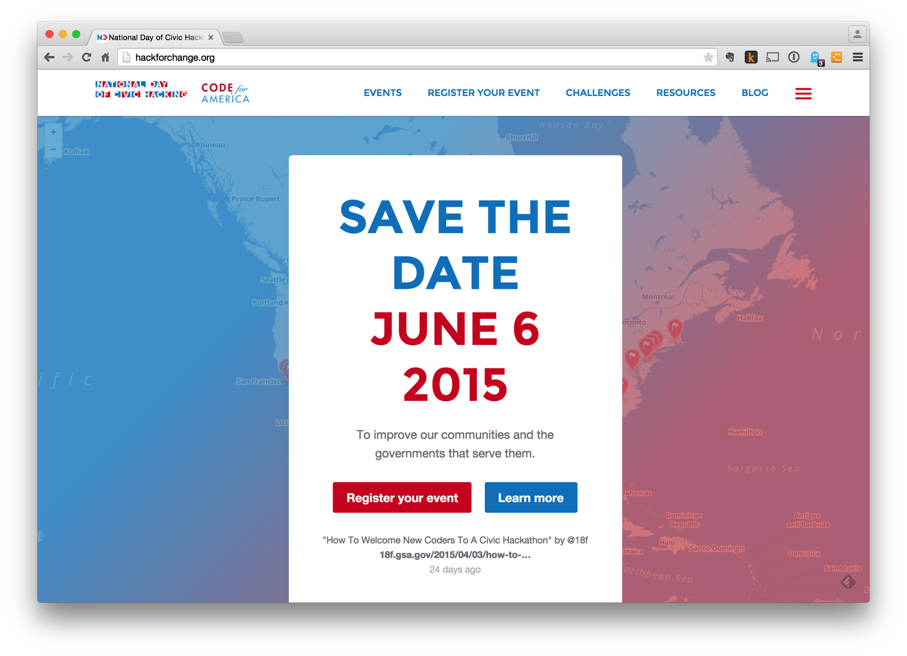

Slide 67
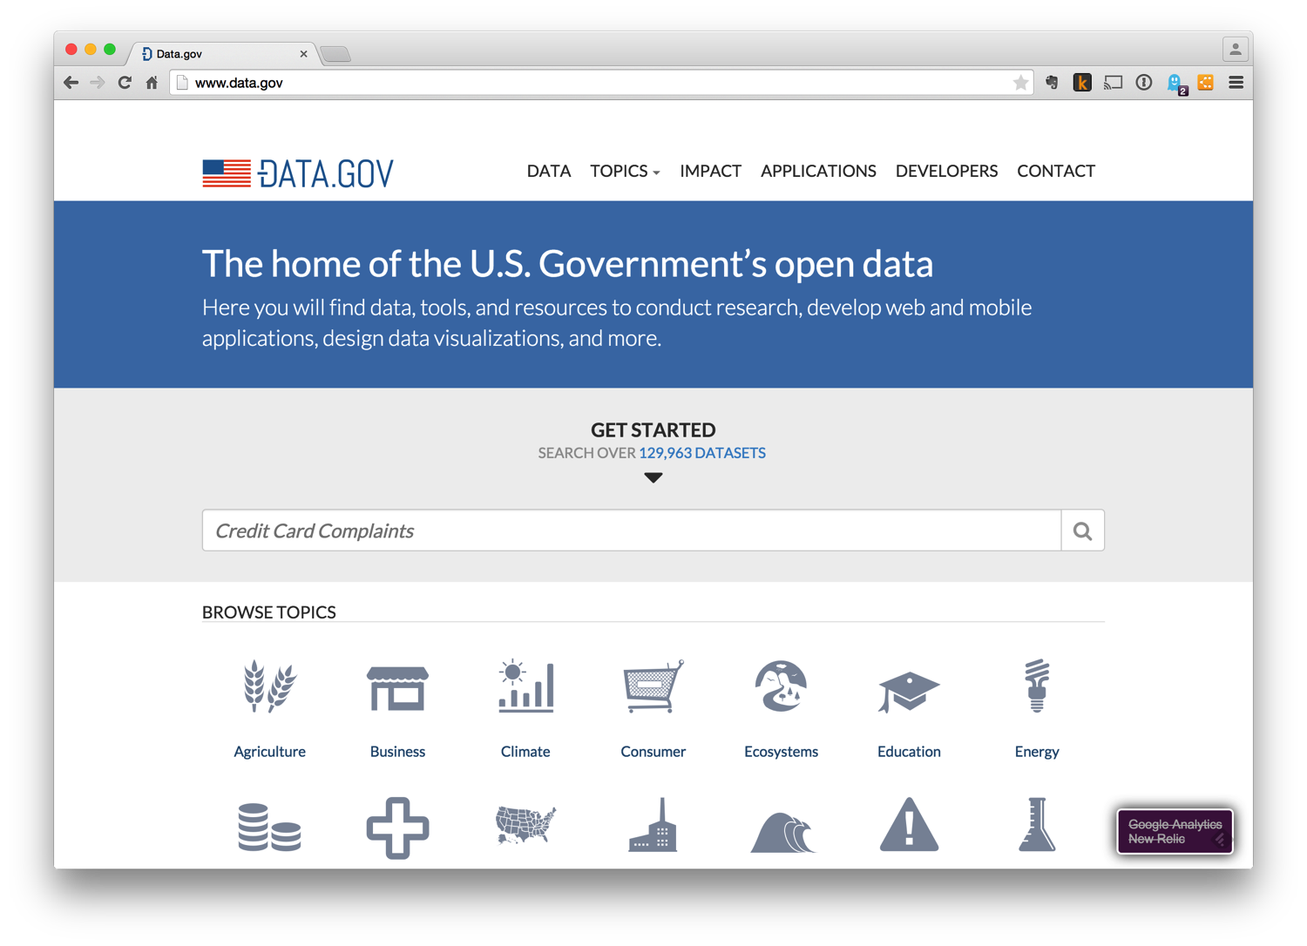

Slide 68
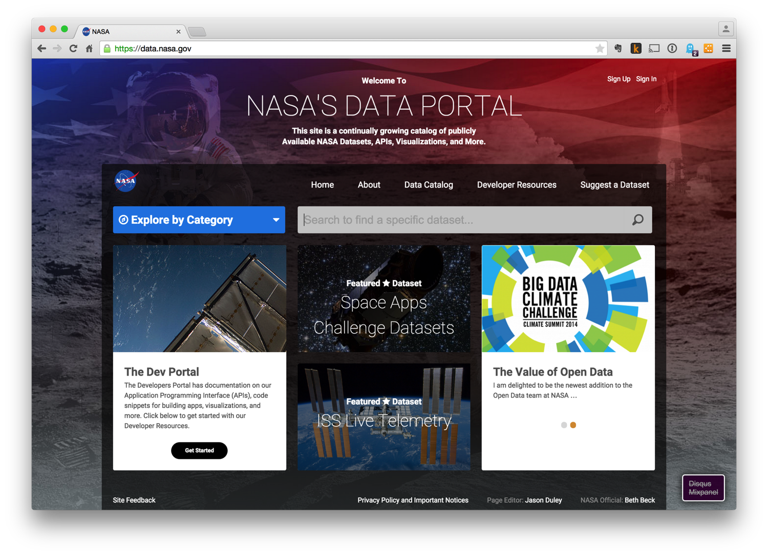

Slide 69
“So, good night unto you all.”
Puck -- A Midsummer-Night’s Dream

Slide 70


Slide 71
Jerry D’Antonio
@jerrydantonio
jerry.dantonio@gmail.com
http://www.jerrydantonio.com
https://github.com/jdantonio
http://www.meetup.com/AkronCodeClub

